Slide 1
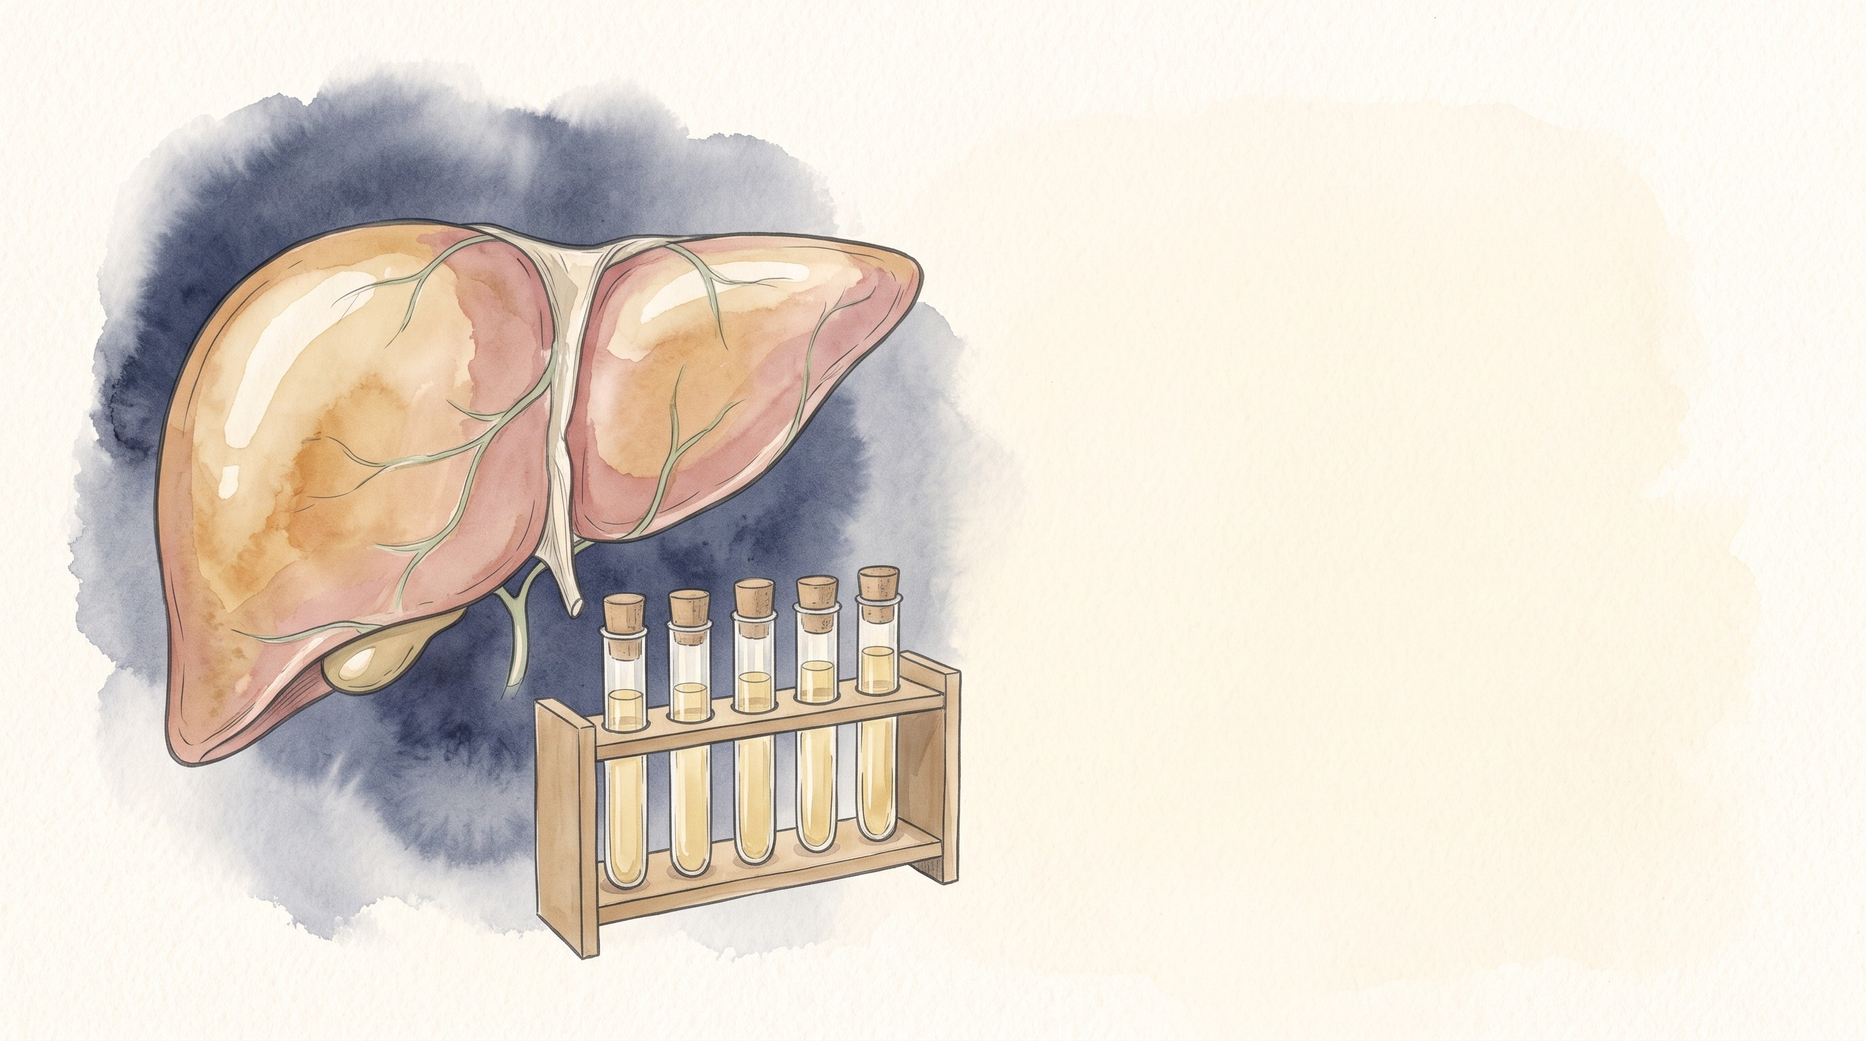


Chronic Hepatitis B
Mohammad Almeqdadi, MD
Transplant Hepatologist and Gastroenterologist
Assistant Professor of Medicine and Surgery
X: @mfalmeqdadi
Slides (PDF)
Illustrations generated with Google Gemini
Notes:
Everything in the cases is made up for teaching; none of it is a real patient. Three patients carry the talk: a man we follow from age 34 to 57, a woman about to start rituximab, and a pregnant woman.

Slide 2
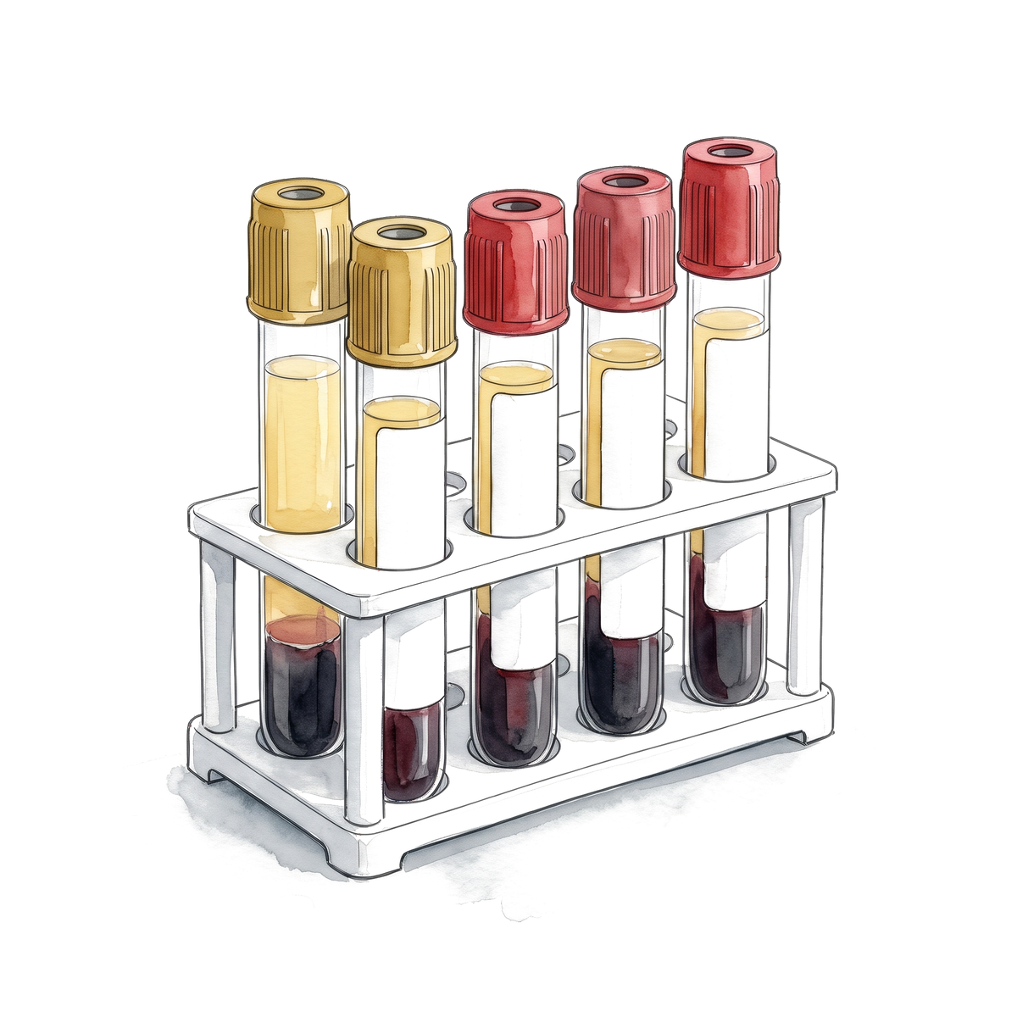
Objectives
By the end of this talk you should be able to:
Read a hepatitis B serology panel
Place a patient in the right phase
Decide who to treat, using the current guidelines
Estimate HCC risk and set up surveillance
Prevent reactivation and transmission to the baby
2/38
Notes:
Several of the recommendations changed in the last two years: AASLD/IDSA 2025, EASL 2025, WHO 2024. Where the guidelines disagree I show them side by side.

Slide 3
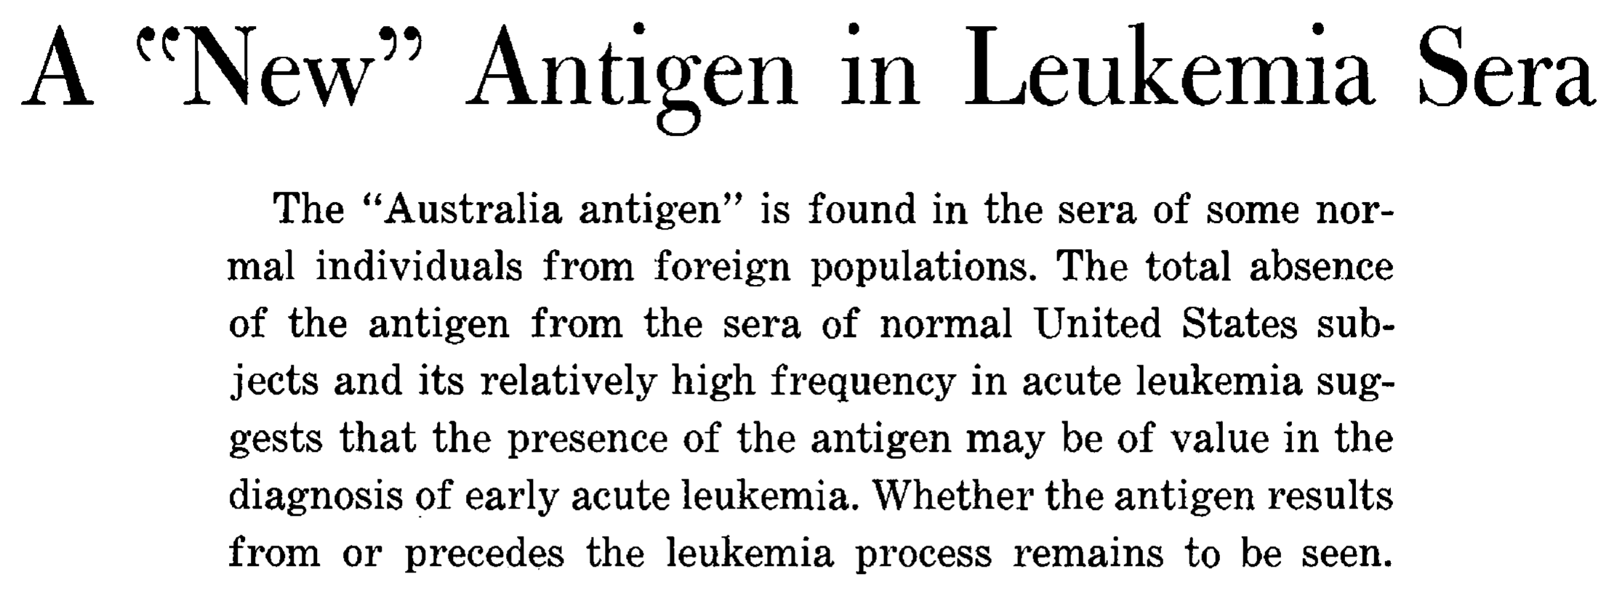
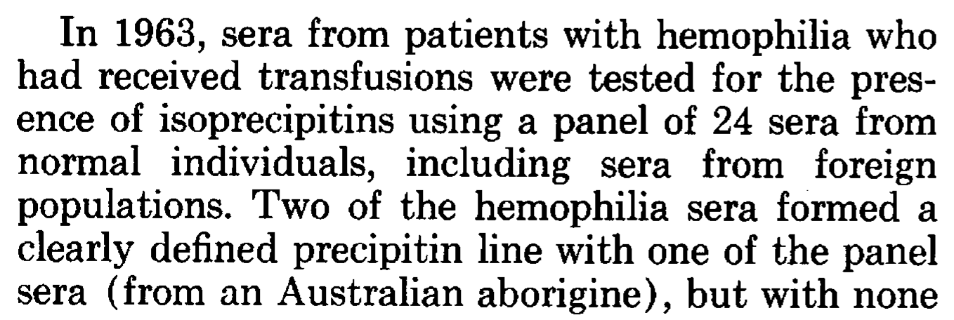
The Australia antigen
Found in the serum of some normal people from foreign populations, and in none of the normal US subjects
Frequent in acute leukemia, which is why the paper is about leukemia
Blumberg shared the 1976 Nobel Prize with Carleton Gajdusek
Blumberg BS, Alter HJ, Visnich S. JAMA 1965;191:541-546. PMID 14239025.
3/38
Notes:
Tell the story the way you like to. In 1963 the Philadelphia group tested sera from transfused hemophilia patients against a panel of 24 normal sera, including sera from foreign populations. Two hemophilia sera made a precipitin line with one panel serum, from an Australian aborigine. That is where the name comes from. The 1965 paper was about leukemia; the link to hepatitis came later. The Nobel citation reads: 'for their discoveries concerning new mechanisms for the origin and dissemination of infectious diseases' (NIH Nobel page). Source for the slide text is the paper itself (your PDF).

Slide 4
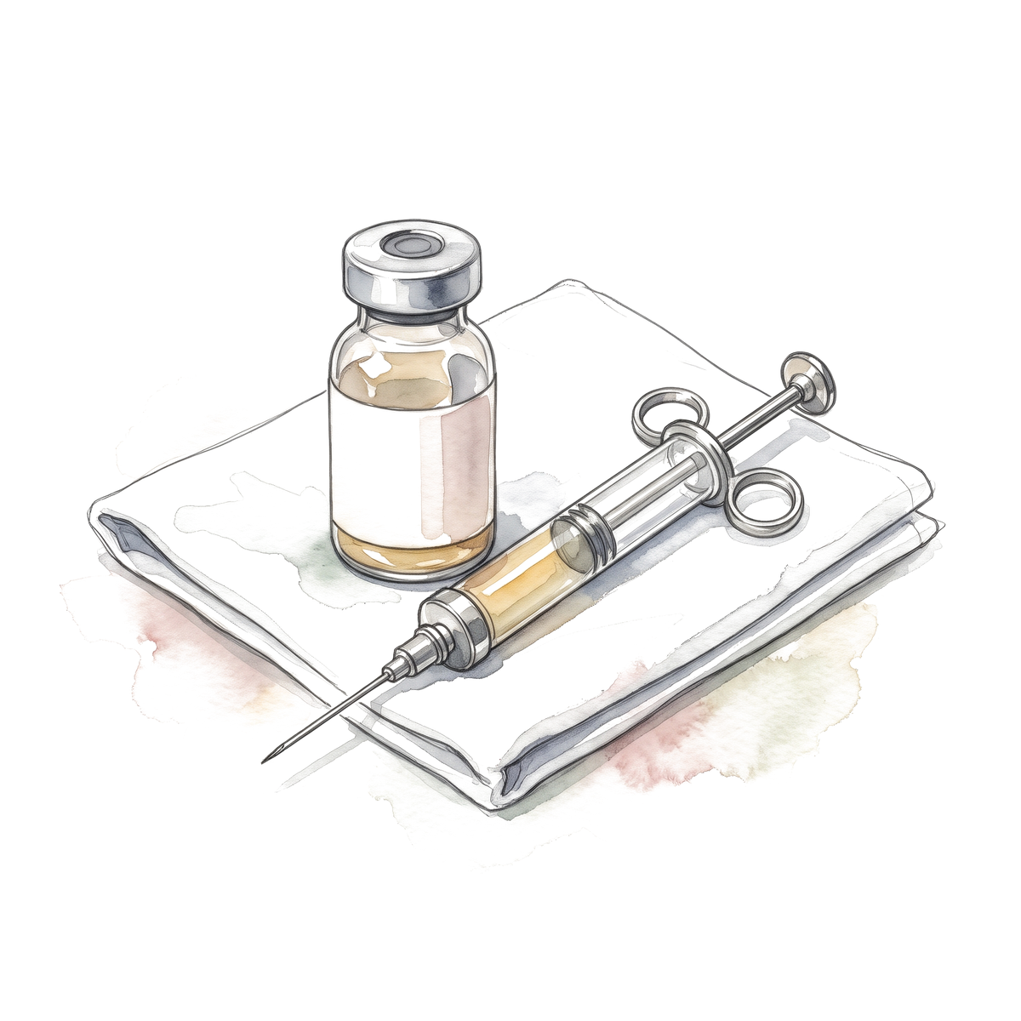
From antigen to vaccine
1965
1970
1976
1980
1981
Blumberg, Alter and Visnich describe the Australia antigen
Dane, Cameron and Briggs see the virus particle in serum
Blumberg and Gajdusek receive the Nobel Prize. First immunization of people with plasma-derived vaccine (Maupas)
Szmuness: the vaccine works in a controlled trial of 1,083 men
Beasley: HBsAg carriers in Taiwan get liver cancer at a far higher rate
PMIDs: Dane 4190997; Maupas 59012; Szmuness 6997738; Beasley 6118576.
4/38
Notes:
Keep it short in the 30-minute version. Dane 1970 Lancet 1:695-698. Maupas 1976 Lancet 1:1367-1370. Szmuness 1980 NEJM 303:833-841. Beasley 1981 Lancet 2:1129-1133. The vaccine came before there was a screening test for liver cancer. A recombinant yeast vaccine was reported in 1984 (McAleer, Nature 307:178-180).

Slide 5
Hepatitis B worldwide
How many people with chronic hepatitis B know it?
100%
Living with chronic hepatitis B (254 million)
Diagnosed
Treated (about 7 million)
WHO news release 9 April 2024 (2022 estimates), rounded. WHO Global hepatitis report 2024.
5/38
Notes:
Let them guess. Answer: about 13% diagnosed and about 3% treated. WHO 2022 estimates: 254 million living with chronic HBV, 1.2 million new infections a year, 1.3 million deaths from HBV and HCV combined, 83% of them HBV. The rounded WHO release is the source; the full report PDF was not opened. In the US, CDC estimates 580,000 to 2.4 million people living with chronic HBV, about two-thirds unaware (CDC 2023, PMID 36893044).

Slide 6
Hepatitis B worldwide
How many people with chronic hepatitis B know it?
100%
13%
3%
Living with chronic hepatitis B (254 million)
Diagnosed
Treated (about 7 million)
WHO news release 9 April 2024 (2022 estimates), rounded. WHO Global hepatitis report 2024.
5/38
Notes:
Let them guess. Answer: about 13% diagnosed and about 3% treated. WHO 2022 estimates: 254 million living with chronic HBV, 1.2 million new infections a year, 1.3 million deaths from HBV and HCV combined, 83% of them HBV. The rounded WHO release is the source; the full report PDF was not opened. In the US, CDC estimates 580,000 to 2.4 million people living with chronic HBV, about two-thirds unaware (CDC 2023, PMID 36893044).

Slide 7
Screening an adult for hepatitis B
Which three tests make up the screening panel?
Question | Test
Is there a current infection?
Is the patient immune?
Has the patient ever been exposed?
CDC recommendations, MMWR Recomm Rep 2023;72(1):1-25, PMID 36893044.
6/38
Notes:
CDC 2023: screen every adult 18 and older at least once with the triple panel, regardless of disclosed risk, and screen in each pregnancy. HBsAg alone misses anti-HBc-only patients, who are the ones at risk of reactivation. Vaccination: all adults 19 to 59 (ACIP 2022); Heplisav-B, Engerix-B and Recombivax HB are in use. PreHevbrio was withdrawn in November 2024 because the company closed, not for safety.

Slide 8
Screening an adult for hepatitis B
Which three tests make up the screening panel?
Question | Test
Is there a current infection? | HBsAg
Is the patient immune? | Anti-HBs
Has the patient ever been exposed? | Total anti-HBc
Once for every adult 18 and older, and in every pregnancy
CDC recommendations, MMWR Recomm Rep 2023;72(1):1-25, PMID 36893044.
6/38
Notes:
CDC 2023: screen every adult 18 and older at least once with the triple panel, regardless of disclosed risk, and screen in each pregnancy. HBsAg alone misses anti-HBc-only patients, who are the ones at risk of reactivation. Vaccination: all adults 19 to 59 (ACIP 2022); Heplisav-B, Engerix-B and Recombivax HB are in use. PreHevbrio was withdrawn in November 2024 because the company closed, not for safety.

Slide 9
Five panels
What does each panel mean?
 | HBsAg | Total anti-HBc | IgM anti-HBc | Anti-HBs | Interpretation
Panel 1 | – | – | – | –
Panel 2 | – | – | – | +
Panel 3 | – | + | – | +
Panel 4 | + | + | – | –
Panel 5 | + | + | + | –
Interpretation per CDC 2023 (Table 1), MMWR Recomm Rep 2023;72(1):1-25.
7/38
Notes:
Chronic means HBsAg present for more than 6 months, so panel 4 needs a repeat. IgM anti-HBc also turns positive during a flare of chronic hepatitis B or a reactivation, so IgM plus a high ALT is not always acute infection: look at the history and the DNA. Resolved infection can reactivate under immunosuppression, which leads to the next slide.

Slide 10
Five panels
What does each panel mean?
 | HBsAg | Total anti-HBc | IgM anti-HBc | Anti-HBs | Interpretation
Panel 1 | – | – | – | – | Susceptible
Panel 2 | – | – | – | + | Vaccinated
Panel 3 | – | + | – | + | Resolved infection
Panel 4 | + | + | – | – | Chronic infection
Panel 5 | + | + | + | – | Acute infection
Interpretation per CDC 2023 (Table 1), MMWR Recomm Rep 2023;72(1):1-25.
7/38
Notes:
Chronic means HBsAg present for more than 6 months, so panel 4 needs a repeat. IgM anti-HBc also turns positive during a flare of chronic hepatitis B or a reactivation, so IgM plus a high ALT is not always acute infection: look at the history and the DNA. Resolved infection can reactivate under immunosuppression, which leads to the next slide.

Slide 11
61-year-old woman starting rituximab
HBsAg | Total anti-HBc | Anti-HBs | HBV DNA | ALT
– | + | – | Not done | 28 U/L
What could this be, and what do you order?
Possibility | How you sort it out
CDC 2023 (Table 1), PMID 36893044; AASLD 2018 hepatitis B guidance, PMID 29405329.
8/38
Notes:
Isolated anti-HBc is not the same as occult infection: occult needs detectable HBV DNA with a negative HBsAg. Order HBV DNA and repeat the panel. Whatever the answer, a patient who is anti-HBc positive and about to get an anti-CD20 drug needs prophylaxis (we come back to this). Wording of the last row, 'repeat testing', is my summary of the CDC table; check it.

Slide 12
61-year-old woman starting rituximab
HBsAg | Total anti-HBc | Anti-HBs | HBV DNA | ALT
– | + | – | Not done | 28 U/L
What could this be, and what do you order?
Possibility | How you sort it out
Resolved infection, anti-HBs has waned | HBV DNA undetectable
Occult infection | HBV DNA detectable
Window period | IgM anti-HBc positive
False-positive anti-HBc | Repeat testing, DNA undetectable
CDC 2023 (Table 1), PMID 36893044; AASLD 2018 hepatitis B guidance, PMID 29405329.
8/38
Notes:
Isolated anti-HBc is not the same as occult infection: occult needs detectable HBV DNA with a negative HBsAg. Order HBV DNA and repeat the panel. Whatever the answer, a patient who is anti-HBc positive and about to get an anti-CD20 drug needs prophylaxis (we come back to this). Wording of the last row, 'repeat testing', is my summary of the CDC table; check it.

Slide 13
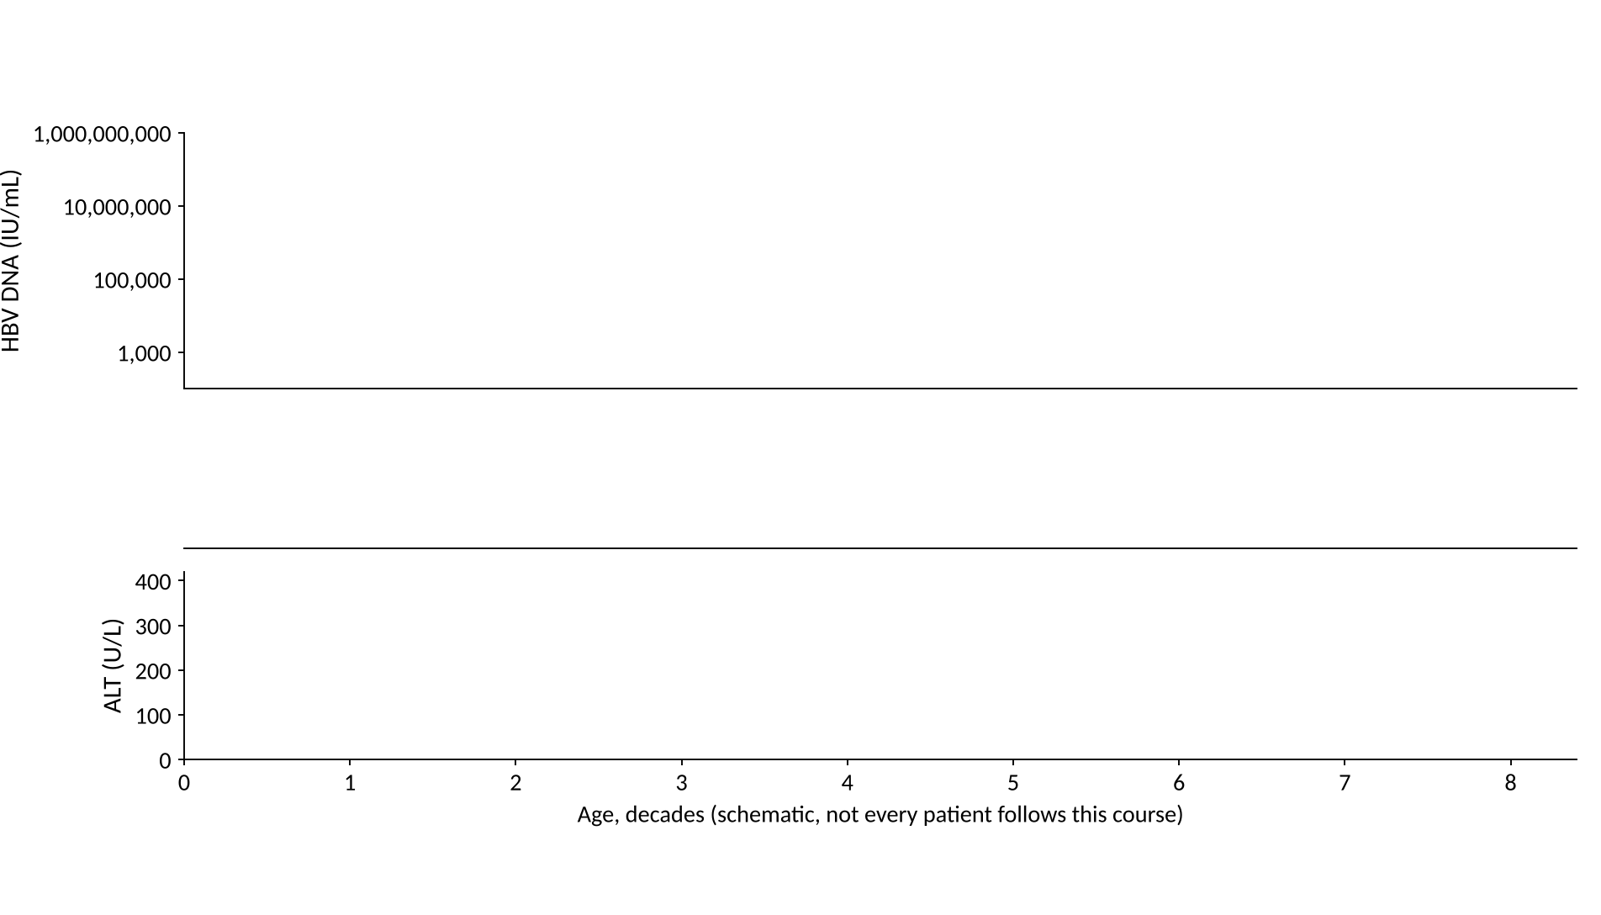
Natural history of chronic hepatitis B
Where do HBV DNA, ALT and the antigens go over a lifetime?
9/38
Notes:
Draw it with the room: three panels, age in decades along the bottom. This is the figure from your sketch. Schematic, not data.

Slide 14
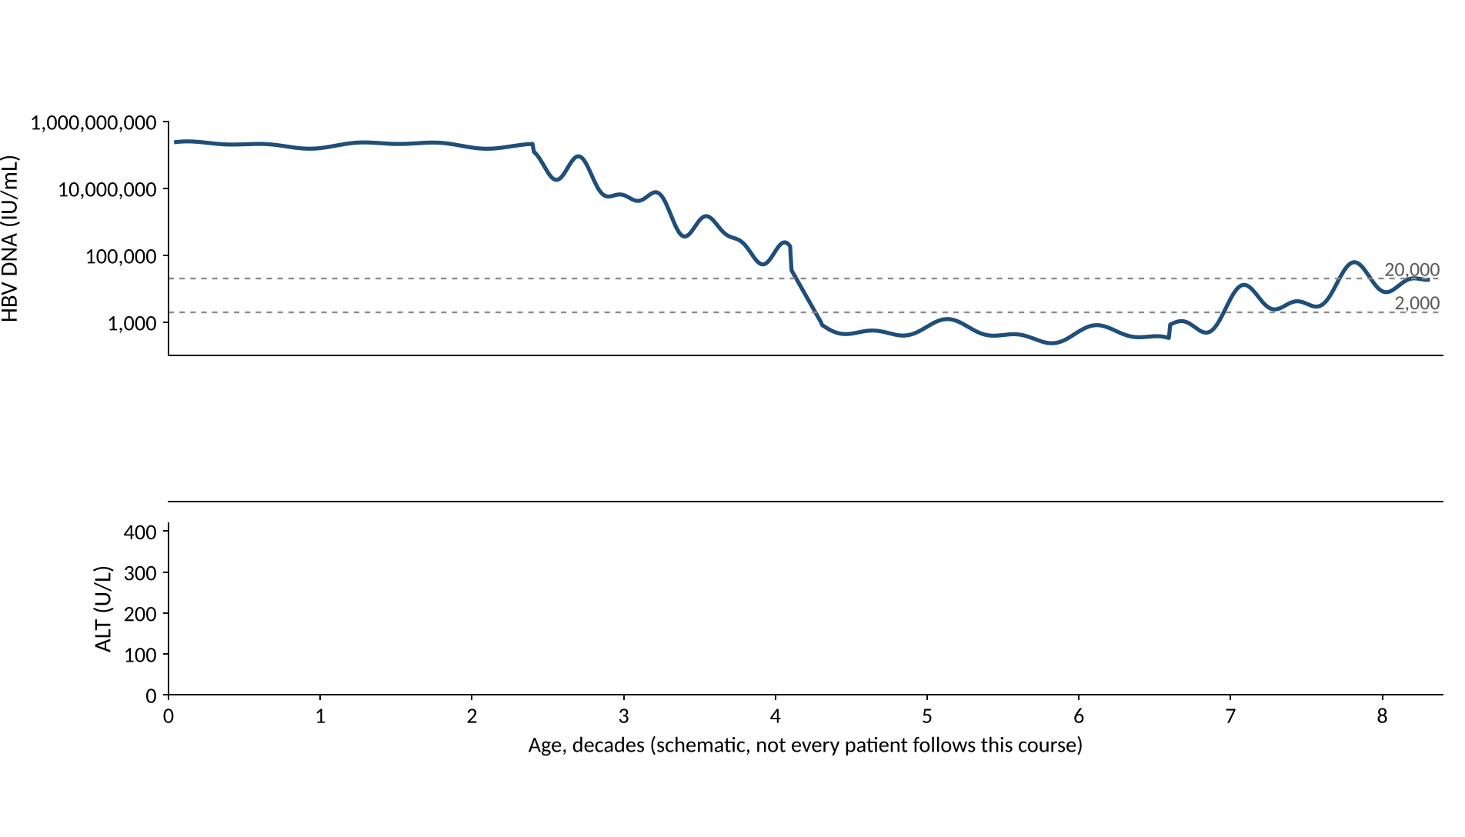
Natural history of chronic hepatitis B
9/38
Notes:
HBV DNA first. Very high in early life, falls in the third and fourth decades, then either stays low or rises again. The dashed lines are 20,000 and 2,000 IU/mL.

Slide 15
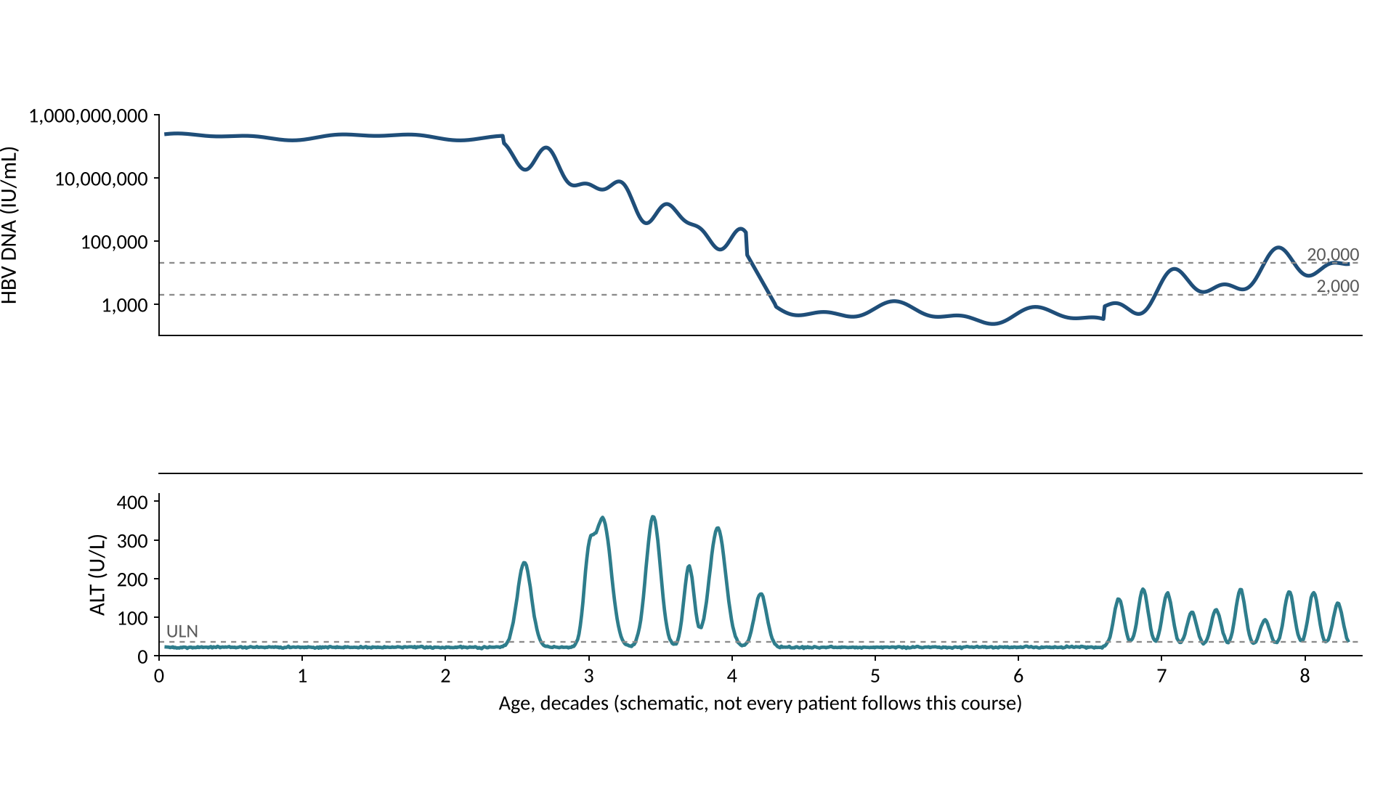
Natural history of chronic hepatitis B
9/38
Notes:
Now ALT. Normal for decades, then flares when the immune system finally attacks. Each flare can cause fibrosis.

Slide 16
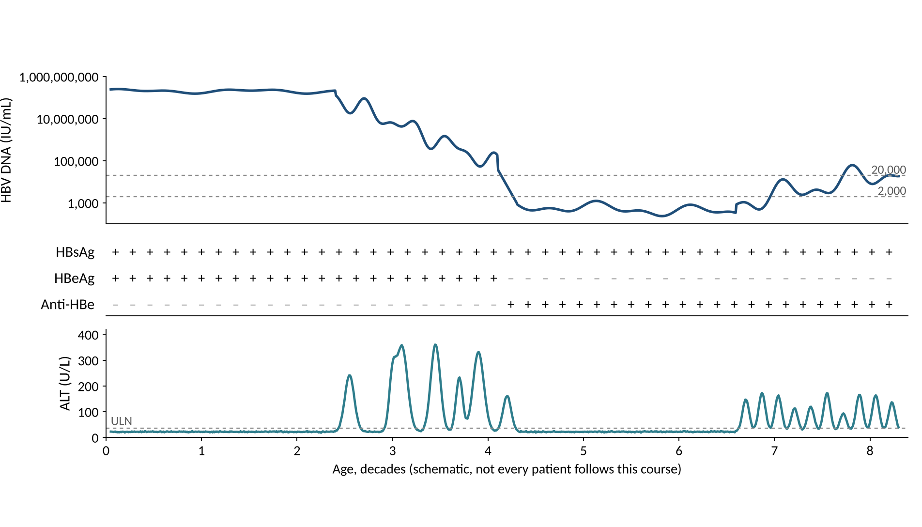
Natural history of chronic hepatitis B
9/38
Notes:
The antigens. HBsAg stays positive. HBeAg is lost and anti-HBe appears when the patient seroconverts, around the fourth decade in this schematic.

Slide 17
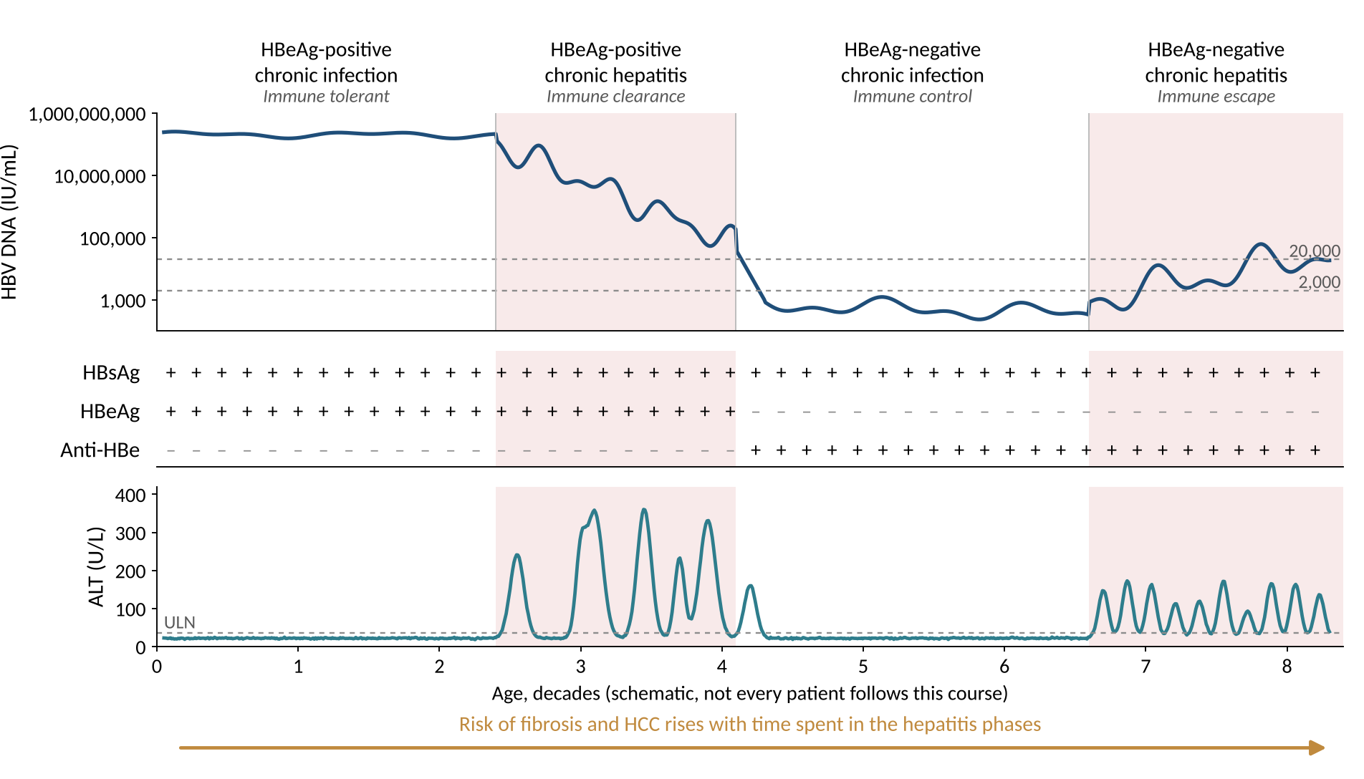
Natural history of chronic hepatitis B
9/38
Notes:
Now name the phases. New names above, old names below. The shaded phases are the hepatitis phases. Not every patient goes through all four, and the age axis is schematic.

Slide 18
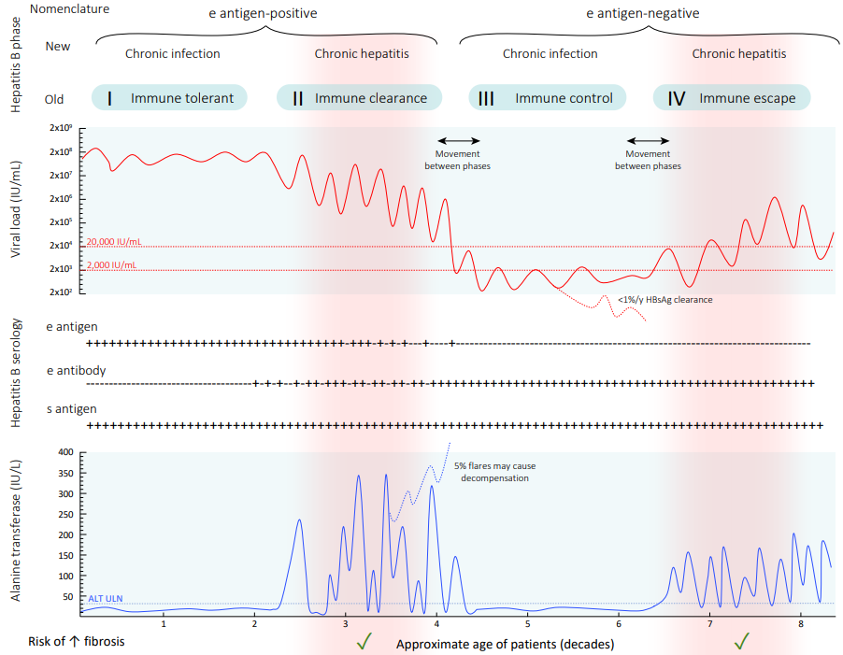
The published version
GESA Australian consensus recommendations for the management of hepatitis B infection, 2022, Figure 3.1 (as shown in the ASHM B Positive chapter).
10/38
Notes:
The same four phases in the published form. Credit GESA 2022 (ASHM attributes Figure 3.1 to them). The reviewer could not confirm the original artist or the reuse licence, so check before putting this in anything you distribute.

Slide 19
Match the labs to the phase
HBeAg | HBV DNA (IU/mL) | ALT | Phase
Positive | 10,000,000 or more | Normal
Positive | 10,000 to 10,000,000 | Raised
Negative | Below 2,000 | Normal
Negative | Above 2,000 | Raised
EASL Clinical Practice Guidelines on hepatitis B 2025, Table 4. J Hepatol 2025;83:502-583, PMID 40348683. Values are 'usually'.
11/38
Notes:
Old names: immune tolerant, immune clearance (immune-active), inactive carrier or immune control, immune escape. AASLD 2018 uses immune-tolerant, HBeAg-positive immune-active, inactive and HBeAg-negative immune-active CHB. These are descriptions of phases, not treatment criteria. A patient can move between phases, and HBsAg loss is a fifth state (HBsAg-negative phase).

Slide 20
Match the labs to the phase
HBeAg | HBV DNA (IU/mL) | ALT | Phase
Positive | 10,000,000 or more | Normal | HBeAg-positive chronic infection
Positive | 10,000 to 10,000,000 | Raised | HBeAg-positive chronic hepatitis
Negative | Below 2,000 | Normal | HBeAg-negative chronic infection
Negative | Above 2,000 | Raised | HBeAg-negative chronic hepatitis
EASL Clinical Practice Guidelines on hepatitis B 2025, Table 4. J Hepatol 2025;83:502-583, PMID 40348683. Values are 'usually'.
11/38
Notes:
Old names: immune tolerant, immune clearance (immune-active), inactive carrier or immune control, immune escape. AASLD 2018 uses immune-tolerant, HBeAg-positive immune-active, inactive and HBeAg-negative immune-active CHB. These are descriptions of phases, not treatment criteria. A patient can move between phases, and HBsAg loss is a fifth state (HBsAg-negative phase).

Slide 21
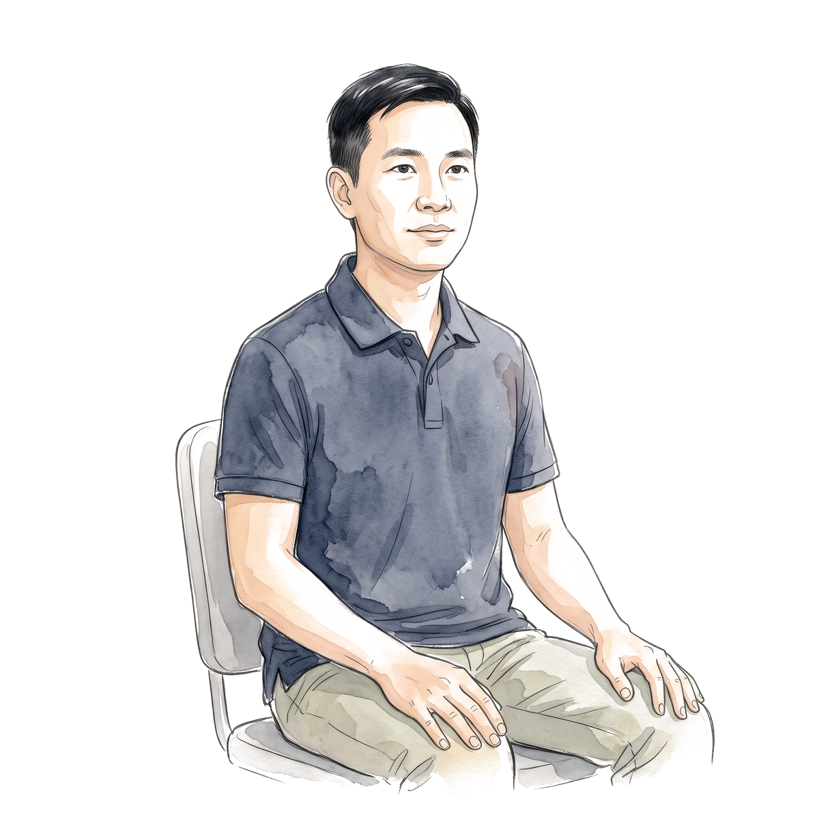
34-year-old man, born in Vietnam
Test | Result
HBsAg | Positive
HBeAg | Positive
Anti-HBe | Negative
HBV DNA | 60,000,000 IU/mL
ALT (ULN 35) | 24 U/L
Platelets | 245 x 10^9/L
Liver stiffness | 5.1 kPa
Do you treat him?
12/38
Notes:
HBsAg found at a blood donation, asymptomatic, ALT normal on two checks six months apart. This is the HBeAg-positive chronic infection (immune tolerant) phase. AASLD/IDSA 2025 R3 defines it as HBeAg positive, DNA above 10,000,000 IU/mL and persistently normal ALT on at least two measurements 6 months apart. At 34, no fibrosis, the recommendation is to monitor. AASLD 2018 R2A: against antiviral therapy in immune-tolerant adults. Stiffness 5.1 kPa is below the EASL F2 cut-off of 7 kPa. All values are made up.

Slide 22
34-year-old man, born in Vietnam
Test | Result
HBsAg | Positive
HBeAg | Positive
Anti-HBe | Negative
HBV DNA | 60,000,000 IU/mL
ALT (ULN 35) | 24 U/L
Platelets | 245 x 10^9/L
Liver stiffness | 5.1 kPa
Do you treat him?
No. Monitor ALT and DNA every 3 to 6 months
12/38
Notes:
HBsAg found at a blood donation, asymptomatic, ALT normal on two checks six months apart. This is the HBeAg-positive chronic infection (immune tolerant) phase. AASLD/IDSA 2025 R3 defines it as HBeAg positive, DNA above 10,000,000 IU/mL and persistently normal ALT on at least two measurements 6 months apart. At 34, no fibrosis, the recommendation is to monitor. AASLD 2018 R2A: against antiviral therapy in immune-tolerant adults. Stiffness 5.1 kPa is below the EASL F2 cut-off of 7 kPa. All values are made up.

Slide 23
Same man, now 41 years old
Test | Result
HBsAg | Positive
HBeAg | Positive
Anti-HBe | Negative
HBV DNA | 55,000,000 IU/mL
ALT (ULN 35) | 26 U/L
Platelets | 245 x 10^9/L
Liver stiffness | 5.1 kPa
Does the answer change?
13/38
Notes:
AASLD/IDSA 2025 R3 (conditional, very low certainty): for immune-tolerant adults, antiviral therapy is supported if over 40 or with grade 2 / stage 2 or worse disease. The recommendation text says 'over 40' and the guideline's algorithm says '40 or more'. The evidence is observational and the AASLD technical review calls it very uncertain, so this is a shared decision. EASL 2025 and WHO 2024 reach treatment through other pathways (fibrosis, family history of HCC); they do not use this age rule in the same way. The same labs at 34 and 41 make the point about age. In our story he hears the options and chooses to keep monitoring, which is why he is untreated at 52; R3 is a conditional recommendation, so that is a reasonable choice.

Slide 24
Same man, now 41 years old
Test | Result
HBsAg | Positive
HBeAg | Positive
Anti-HBe | Negative
HBV DNA | 55,000,000 IU/mL
ALT (ULN 35) | 26 U/L
Platelets | 245 x 10^9/L
Liver stiffness | 5.1 kPa
Does the answer change?
AASLD/IDSA 2025: over 40, treatment is suggested. He chose to wait
13/38
Notes:
AASLD/IDSA 2025 R3 (conditional, very low certainty): for immune-tolerant adults, antiviral therapy is supported if over 40 or with grade 2 / stage 2 or worse disease. The recommendation text says 'over 40' and the guideline's algorithm says '40 or more'. The evidence is observational and the AASLD technical review calls it very uncertain, so this is a shared decision. EASL 2025 and WHO 2024 reach treatment through other pathways (fibrosis, family history of HCC); they do not use this age rule in the same way. The same labs at 34 and 41 make the point about age. In our story he hears the options and chooses to keep monitoring, which is why he is untreated at 52; R3 is a conditional recommendation, so that is a reasonable choice.

Slide 25

Same man, now 52 years old
Test | Result
HBsAg | Positive
HBeAg | Negative
Anti-HBe | Positive
HBV DNA | 8,000 IU/mL
ALT | 48 U/L
Platelets | 190 x 10^9/L
FIB-4 | 1.8
Liver stiffness | 6.8 kPa
Do you treat him?
14/38
Notes:
He lost HBeAg and seroconverted in his late 40s. DNA 8,000, ALT 48 (1.4 times the AASLD upper limit of 35), no advanced fibrosis. Let the room commit. The next slide shows what each guideline says.

Slide 26
What counts as a normal ALT?
His ALT
48 U/L
Above all three limits
Upper limits of normal as listed in the guidelines. AASLD 2018 PMID 29405329; WHO 2024; EASL 2025 PMID 40348683.
15/38
Notes:
The old reference ranges included people with fatty liver, which is why the blood-donor data gave lower limits (30 for men and 19 for women in the ASHM chapter). Whichever limit you use, 48 is raised. Next slide: what each guideline does with it.

Slide 27
Same labs, four guidelines
Treat or not?
 | AASLD 2018 | AASLD/IDSA 2025 | EASL 2025 | WHO 2024
52 y, HBeAg-negative, DNA 8,000, ALT 48
Compensated cirrhosis, DNA 500
Decompensated cirrhosis, any DNA
AASLD 2018 PMID 29405329; AASLD/IDSA 2025 Hepatology 2026;83:974-997 PMID 41186418; EASL 2025 PMID 40348683; WHO 2024 (NBK614987).
16/38
Notes:
Row 1: AASLD 2018 treats HBeAg-negative patients with DNA above 2,000 and ALT at least 2 times the upper limit (70 for a man) or significant histology, so he is observed. AASLD/IDSA 2025 R4 suggests treatment by shared decision in the indeterminate group. EASL 2025: DNA at least 2,000 with ALT above the upper limit or at least F2: treat. WHO 2024: DNA above 2,000 and ALT above the upper limit: treat. Rows 2 and 3 are the cirrhosis rows: AASLD 2018 R7A and R7B, AASLD/IDSA 2025 Figure 5, EASL (detectable DNA, any DNA if decompensated), WHO (treat regardless of DNA and ALT). The reviewer's dossier (section B1) has the full matrix. APASL 2026 criteria were not opened, so they are not shown.

Slide 28
Same labs, four guidelines
Treat or not?
 | AASLD 2018 | AASLD/IDSA 2025 | EASL 2025 | WHO 2024
52 y, HBeAg-negative, DNA 8,000, ALT 48 | Observe | Shared decision | Treat | Treat
Compensated cirrhosis, DNA 500 | Treat | Treat | Treat | Treat
Decompensated cirrhosis, any DNA | Treat | Treat | Treat | Treat
AASLD 2018 PMID 29405329; AASLD/IDSA 2025 Hepatology 2026;83:974-997 PMID 41186418; EASL 2025 PMID 40348683; WHO 2024 (NBK614987).
16/38
Notes:
Row 1: AASLD 2018 treats HBeAg-negative patients with DNA above 2,000 and ALT at least 2 times the upper limit (70 for a man) or significant histology, so he is observed. AASLD/IDSA 2025 R4 suggests treatment by shared decision in the indeterminate group. EASL 2025: DNA at least 2,000 with ALT above the upper limit or at least F2: treat. WHO 2024: DNA above 2,000 and ALT above the upper limit: treat. Rows 2 and 3 are the cirrhosis rows: AASLD 2018 R7A and R7B, AASLD/IDSA 2025 Figure 5, EASL (detectable DNA, any DNA if decompensated), WHO (treat regardless of DNA and ALT). The reviewer's dossier (section B1) has the full matrix. APASL 2026 criteria were not opened, so they are not shown.

Slide 29
Does treating this group help?
Study | Design | Patients | Outcome
Huang 2023 | Observational | 855, no advanced fibrosis | HCC, 5 to 15 years
TORCH-B 2021 | Randomized | 160, ALT 1 to 2 x ULN | Progression at 3 years
What do you expect?
Huang DQ et al. Hepatology 2023;78:1558-1568, PMID 37184202. Hsu YC et al. Lancet Infect Dis 2021;21:823-833, PMID 33524314.
17/38
Notes:
Huang: 855 patients in the indeterminate phase without advanced fibrosis; weighted analysis, adjusted HR for HCC 0.30 (0.10 to 0.60). Treated 3, 4 and 9% at 5, 10 and 15 years, untreated 3, 15 and 19%. Observational, so residual confounding remains. TORCH-B: 160 Taiwanese patients, TDF 300 mg for 3 years versus placebo, paired biopsies: progression of at least one Ishak stage 19/73 (26%) versus 34/73 (47%), RR 0.56 (0.35 to 0.88). Randomized, but small and not powered for HCC. ATTENTION (interim, Lancet Gastroenterol Hepatol 2025, 734 patients, TAF versus observation): primary composite events 2 versus 9, HR 0.21, 97.5% CI 0.04 to 1.20, did not cross its stopping boundary. None of these randomized treatment against HCC. Mention the counterweight (Jeon 2021: no HCC at 5 years in biomarker-defined immune tolerance with FIB-4 under 1.45).

Slide 30
Does treating this group help?
Study | Design | Patients | Outcome
Huang 2023 | Observational | 855, no advanced fibrosis | HCC, 5 to 15 years
TORCH-B 2021 | Randomized | 160, ALT 1 to 2 x ULN | Progression at 3 years
Cumulative HCC risk, %
Histologic progression, %
Huang DQ et al. Hepatology 2023;78:1558-1568, PMID 37184202. Hsu YC et al. Lancet Infect Dis 2021;21:823-833, PMID 33524314.
17/38
Notes:
Huang: 855 patients in the indeterminate phase without advanced fibrosis; weighted analysis, adjusted HR for HCC 0.30 (0.10 to 0.60). Treated 3, 4 and 9% at 5, 10 and 15 years, untreated 3, 15 and 19%. Observational, so residual confounding remains. TORCH-B: 160 Taiwanese patients, TDF 300 mg for 3 years versus placebo, paired biopsies: progression of at least one Ishak stage 19/73 (26%) versus 34/73 (47%), RR 0.56 (0.35 to 0.88). Randomized, but small and not powered for HCC. ATTENTION (interim, Lancet Gastroenterol Hepatol 2025, 734 patients, TAF versus observation): primary composite events 2 versus 9, HR 0.21, 97.5% CI 0.04 to 1.20, did not cross its stopping boundary. None of these randomized treatment against HCC. Mention the counterweight (Jeon 2021: no HCC at 5 years in biomarker-defined immune tolerance with FIB-4 under 1.45).

Slide 31
Who to treat: summary
HBsAg positive
Cirrhosis?
Yes
Treat, any DNA level
No
HBeAg positive
HBeAg negative
DNA above 20,000 and ALT 2 times ULN or more
Treat
DNA above 2,000 and ALT 2 times ULN or more
Treat
DNA above 10 million, normal ALT, over 40 or F2 or worse
Treatment suggested
Between the two: the grey zone
Shared decision
DNA above 10 million, normal ALT, 40 or younger, no fibrosis
Monitor
DNA below 2,000, normal ALT
Monitor
AASLD 2018 (PMID 29405329); AASLD/IDSA 2025 R3, R4 and Figure 5 (PMID 41186418). ALT ULN 35 men, 25 women.
18/38
Notes:
This is the US version: AASLD 2018 thresholds for immune-active disease, with the two AASLD/IDSA 2025 changes. R3 (conditional, very low certainty): immune-tolerant adults over 40, or with grade 2 / stage 2 or worse disease, are suggested for treatment; the text says over 40 and the algorithm says 40 or more. R4: the indeterminate (grey zone) group is a shared decision. Cirrhosis: AASLD 2018 R7A treats compensated cirrhosis with low viremia regardless of ALT, R7B treats decompensated cirrhosis regardless of DNA, ALT or HBeAg, and the 2025 Figure 5 treats both regardless of DNA or ALT. EASL 2025 and WHO 2024 treat more people: DNA above 2,000 with ALT above ULN, or significant fibrosis. Pregnancy and immunosuppression are separate pathways, covered later. 'Monitor' means ALT and DNA every 3 to 6 months and a fibrosis check.

Slide 32
58-year-old man, eGFR 45
Which nucleos(t)ide analogue?
 | Dose | At eGFR 30 to 49
Entecavir | 0.5 mg daily | 0.5 mg every 48 hours
TDF | 300 mg daily | 300 mg every 48 hours
TAF | 25 mg daily with food | 25 mg daily
US prescribing information: Baraclude, Viread, Vemlidy (DailyMed). Renal doses use creatinine clearance.
19/38
Notes:
The renal rows are from the US labels. Entecavir: for CrCl 30 to 49, 0.25 mg daily or 0.5 mg every 48 hours; use the oral solution for the daily fractions. TDF: CrCl 30 to 49, 300 mg every 48 hours. TAF: no adjustment at CrCl 15 or above. TAF is not recommended in Child-Pugh B or C in the US label, and the old statement that TAF cannot be used on dialysis is out of date. The answer line is my teaching summary, based on the TAF versus TDF trial data on the next slide; confirm it is how you would say it.

Slide 33
58-year-old man, eGFR 45
Which nucleos(t)ide analogue?
 | Dose | At eGFR 30 to 49
Entecavir | 0.5 mg daily | 0.5 mg every 48 hours | Dose-adjust
TDF | 300 mg daily | 300 mg every 48 hours | Dose-adjust, kidney and bone effects
TAF | 25 mg daily with food | 25 mg daily | No adjustment
TAF, or entecavir with the dose adjusted
US prescribing information: Baraclude, Viread, Vemlidy (DailyMed). Renal doses use creatinine clearance.
19/38
Notes:
The renal rows are from the US labels. Entecavir: for CrCl 30 to 49, 0.25 mg daily or 0.5 mg every 48 hours; use the oral solution for the daily fractions. TDF: CrCl 30 to 49, 300 mg every 48 hours. TAF: no adjustment at CrCl 15 or above. TAF is not recommended in Child-Pugh B or C in the US label, and the old statement that TAF cannot be used on dialysis is out of date. The answer line is my teaching summary, based on the TAF versus TDF trial data on the next slide; confirm it is how you would say it.

Slide 34
TAF versus TDF at week 48
HBV DNA below 29 IU/mL | TAF | TDF
HBeAg-positive (Chan) | 64% | 67%
HBeAg-negative (Buti) | 94% | 93%
What differs?
Chan HLY et al. Lancet Gastroenterol Hepatol 2016;1:185-195 (PMID 28404091). Buti M et al. 2016;1:196-206 (PMID 28404092).
20/38
Notes:
Two phase 3 noninferiority trials, 875 HBeAg-positive and 426 HBeAg-negative patients, double-blind. Antiviral efficacy was the same. Bone loss was smaller on TAF at the hip (-0.10% vs -1.72% and -0.29% vs -2.16%) and spine (-0.42% vs -2.29% and -0.88% vs -2.51%). The 96-week pooled analysis (Agarwal, J Hepatol 2018) held up. The 8-year report (Buti, Aliment Pharmacol Ther 2024) switched the TDF arm to TAF at year 2 or 3, so it is not a randomized 8-year comparison. Observational data do not settle entecavir versus tenofovir for HCC (Choi 2023 individual patient meta-analysis HR 0.77, 0.61 to 0.98; Lee 2020 HR 1.03, 0.70 to 1.51).

Slide 35
TAF versus TDF at week 48
Change in bone mineral density, %
HBV DNA below 29 IU/mL | TAF | TDF
HBeAg-positive (Chan) | 64% | 67%
HBeAg-negative (Buti) | 94% | 93%
Median eGFR change in the HBeAg-negative trial: -1.8 (TAF) vs -4.8 mL/min (TDF)
Chan HLY et al. Lancet Gastroenterol Hepatol 2016;1:185-195 (PMID 28404091). Buti M et al. 2016;1:196-206 (PMID 28404092).
20/38
Notes:
Two phase 3 noninferiority trials, 875 HBeAg-positive and 426 HBeAg-negative patients, double-blind. Antiviral efficacy was the same. Bone loss was smaller on TAF at the hip (-0.10% vs -1.72% and -0.29% vs -2.16%) and spine (-0.42% vs -2.29% and -0.88% vs -2.51%). The 96-week pooled analysis (Agarwal, J Hepatol 2018) held up. The 8-year report (Buti, Aliment Pharmacol Ther 2024) switched the TDF arm to TAF at year 2 or 3, so it is not a randomized 8-year comparison. Observational data do not settle entecavir versus tenofovir for HCC (Choi 2023 individual patient meta-analysis HR 0.77, 0.61 to 0.98; Lee 2020 HR 1.03, 0.70 to 1.51).

Slide 36
Choosing the drug: summary
Situation | Drug
Most patients | Entecavir, TDF or TAF
Kidney or bone disease, or at risk | TAF, or entecavir with the dose adjusted
Prior lamivudine resistance | TDF or TAF, not entecavir
Pregnancy | TDF (most data) or TAF
HIV | TDF or TAF as part of ART
Decompensated cirrhosis | Entecavir or TDF (no TAF in Child-Pugh B or C)
Wants a finite course | Pegylated interferon, selected patients
AASLD 2018 (PMID 29405329); AASLD/IDSA 2025 (PMID 41186418); US prescribing information.
21/38
Notes:
AASLD 2018: entecavir, TDF and TAF are first line. Entecavir or TAF are preferred over TDF with renal dysfunction or bone disease, or risk of them. Lamivudine resistance confers cross-resistance to entecavir, so use tenofovir. Entecavir alone is not adequate in HIV: it selects HIV M184V. Pregnancy: TDF has the randomized data; AASLD/IDSA 2025 R1 accepts TDF or TAF. Decompensated cirrhosis: the 2025 Figure 5 lists TAF, but the US label does not recommend it in Child-Pugh B or C, so say that. PegIFN is contraindicated in decompensated cirrhosis and in pregnancy.

Slide 37
Calculating PAGE-B
Variable | Category | Points
Age, years | 16 to 29 | 0
 | 30 to 39 | 2
 | 40 to 49 | 4
 | 50 to 59 | 6
 | 60 to 69 | 8
 | 70 or older | 10
Sex | Female | 0
 | Male | 6
Platelets, x 10^9/L | 200 or more | 0
 | 100 to 199 | 6
 | Under 100 | 9
52-year-old man
Started on TAF
Platelets 190
What is his PAGE-B score?
Points as printed in EASL 2025 Table 13. PAGE-B: Papatheodoridis GV et al. J Hepatol 2016.
22/38
Notes:
PAGE-B was derived in 1,815 White European adults treated with entecavir or tenofovir (1,325 derivation, 490 validation) and has three groups: 9 or less, 10 to 17 and 18 or more. Five-year HCC was 0, 3 and 17% in derivation and 0, 4 and 16% in validation. Platelet boundary: EASL prints 'above 200' and the calculator uses 200 or more; the original paper's boundary at exactly 200 is not yet checked. The PAGE-B column and strata come from the dossier (section E1). He was started on TAF when he was 52, so PAGE-B applies. In a US veterans cohort of 3,101 treated patients (39.5% White, 36.3% Black), PAGE-B had a 3-year AUC of 0.73.

Slide 38
Calculating PAGE-B
Variable | Category | Points
Age, years | 16 to 29 | 0
 | 30 to 39 | 2
 | 40 to 49 | 4
 | 50 to 59 | 6
 | 60 to 69 | 8
 | 70 or older | 10
Sex | Female | 0
 | Male | 6
Platelets, x 10^9/L | 200 or more | 0
 | 100 to 199 | 6
 | Under 100 | 9
52-year-old man
Started on TAF
Platelets 190
6 + 6 + 6 = 18
High risk: 18 or more
5-year HCC about 16 to 17%
Points as printed in EASL 2025 Table 13. PAGE-B: Papatheodoridis GV et al. J Hepatol 2016.
22/38
Notes:
PAGE-B was derived in 1,815 White European adults treated with entecavir or tenofovir (1,325 derivation, 490 validation) and has three groups: 9 or less, 10 to 17 and 18 or more. Five-year HCC was 0, 3 and 17% in derivation and 0, 4 and 16% in validation. Platelet boundary: EASL prints 'above 200' and the calculator uses 200 or more; the original paper's boundary at exactly 200 is not yet checked. The PAGE-B column and strata come from the dossier (section E1). He was started on TAF when he was 52, so PAGE-B applies. In a US veterans cohort of 3,101 treated patients (39.5% White, 36.3% Black), PAGE-B had a 3-year AUC of 0.73.

Slide 39
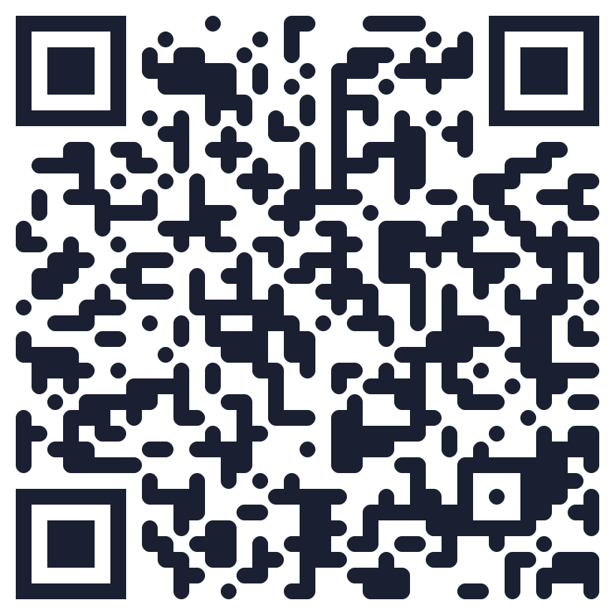
Calculate it yourself
PAGE-B | 5-year HCC, derivation | 5-year HCC, validation
9 or less | 0% | 0%
10 to 17 | 3% | 4%
18 or more | 17% | 16%
PAGE-B was built in treated patients; REACH-B was built in untreated patients
The HBsAg-based model on the site is a 2026 research model, not validated
qaddodi.github.io/chb-hcc-risk
PAGE-B: Papatheodoridis GV et al. J Hepatol 2016. VA validation: Kim 2022.
23/38
Notes:
Your calculator. PAGE-B matches the published table. The second model (HBsAg-HCC, Guo 2026, 1,190 training and 506 validation patients, abstract only) could not be checked against the paper, so say it is a research model, not validated. Do not call it externally verified. The calculator does not include REACH-B, aMAP or REAL-B.

Slide 40
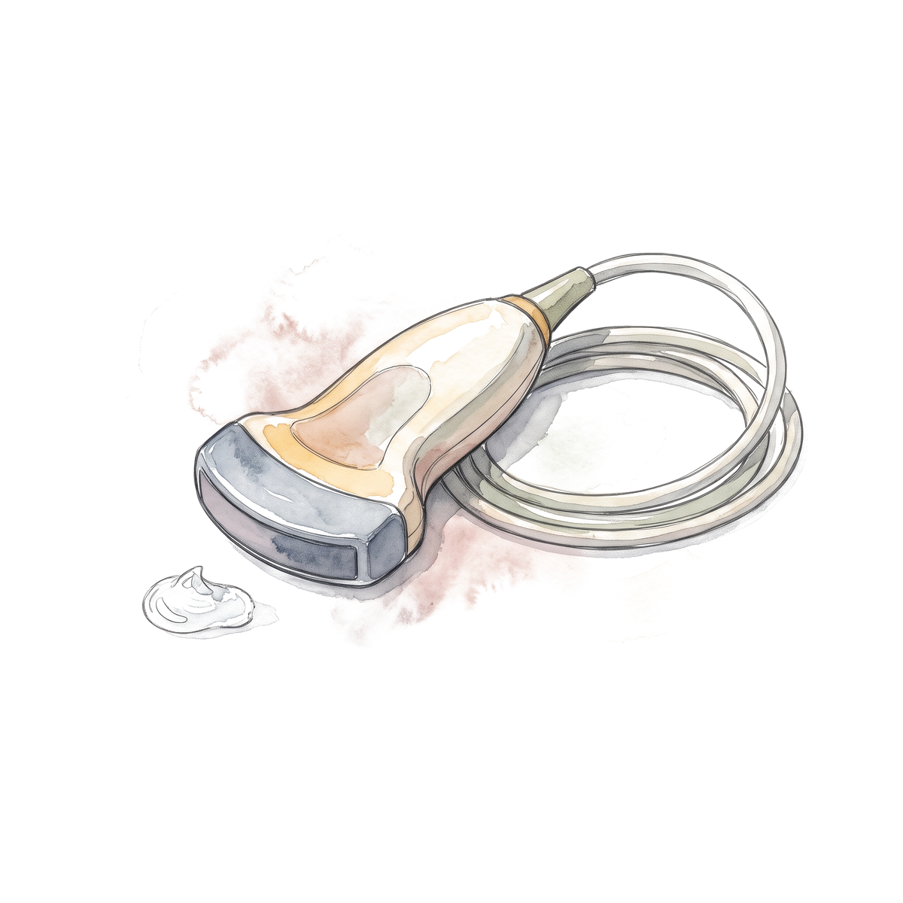
Who gets surveillance?
Ultrasound and AFP every 6 months?
Patient | Surveillance
Compensated cirrhosis, Child-Pugh A
Man from an endemic region, age 38, no cirrhosis
Man from an endemic region, age 46, no cirrhosis
Woman from an endemic region, age 46, no cirrhosis
Family history of HCC
PAGE-B score of 12
AASLD HCC practice guidance 2023, Table 1. Hepatology 2023;78:1922-1965, PMID 37199193.
24/38
Notes:
AASLD 2023 Table 1: noncirrhotic HBV: men over 40 and women over 50 from endemic regions; people of African origin earlier (the wording is origin-based, not an instruction to start every Black American at 20); family history of HCC; PAGE-B 10 or more (the table prints 'over 10' while the score's own intermediate group starts at 10). Ultrasound plus AFP every 6 months (level 2, strong). The thresholds behind these groups are about 0.2% a year for noncirrhotic HBV and 1.0% for cirrhosis. These are model-based decision thresholds, not biological cut-offs. Continue surveillance after HBsAg loss in cirrhosis, family history, men who lost HBsAg after 40 and women after 50 (AASLD/IDSA 2025 R6).

Slide 41
Who gets surveillance?
Ultrasound and AFP every 6 months?
Patient | Surveillance
Compensated cirrhosis, Child-Pugh A | Yes
Man from an endemic region, age 38, no cirrhosis | No
Man from an endemic region, age 46, no cirrhosis | Yes
Woman from an endemic region, age 46, no cirrhosis | No
Family history of HCC | Yes
PAGE-B score of 12 | Yes
AASLD HCC practice guidance 2023, Table 1. Hepatology 2023;78:1922-1965, PMID 37199193.
24/38
Notes:
AASLD 2023 Table 1: noncirrhotic HBV: men over 40 and women over 50 from endemic regions; people of African origin earlier (the wording is origin-based, not an instruction to start every Black American at 20); family history of HCC; PAGE-B 10 or more (the table prints 'over 10' while the score's own intermediate group starts at 10). Ultrasound plus AFP every 6 months (level 2, strong). The thresholds behind these groups are about 0.2% a year for noncirrhotic HBV and 1.0% for cirrhosis. These are model-based decision thresholds, not biological cut-offs. Continue surveillance after HBsAg loss in cirrhosis, family history, men who lost HBsAg after 40 and women after 50 (AASLD/IDSA 2025 R6).

Slide 42
HCC surveillance: summary
Ultrasound and AFP every 6 months
Cirrhosis
No cirrhosis, from an endemic region: men over 40, women over 50; people of African origin earlier
Family history of HCC
PAGE-B 10 or more
Hepatitis D coinfection
Keep going after HBsAg loss if:
Cirrhosis or a family history of HCC, or HBsAg lost after 40 in men and after 50 in women
AASLD HCC guidance 2023, Table 1 (PMID 37199193); AASLD/IDSA 2025 R6 to R9 (PMID 41186418).
25/38
Notes:
AASLD 2023 Table 1 and AASLD/IDSA 2025 R6 to R9 (all conditional, very low certainty). Cirrhosis: Child-Pugh A and B patients who could be treated for HCC; Child C only if a transplant candidate. HIV coinfection: men 18 and older and women 40 and older. HBV and HCV: use the HBV criteria after HCV is treated. Surveillance continues on antivirals even when DNA is suppressed.

Slide 43
Risk of HBV reactivation
How risky is each drug if HBsAg is negative and anti-HBc is positive?
Drug | Reactivation risk
Rituximab or other anti-CD20
Anthracyclines
JAK inhibitors
Prednisone 20 mg or more for 4 weeks or longer
Anti-TNF
Immune checkpoint inhibitors
Methotrexate, azathioprine
AGA guideline 2025, Table 6. Gastroenterology 2025;168:267-284, PMID 39863345. High above 10%, moderate 1 to 10%, low below 1%.
26/38
Notes:
Our patient from earlier: anti-HBc positive, HBsAg negative, starting rituximab. AGA risk categories: high above 10%, moderate 1 to 10%, low below 1%. The risk depends on the drug and on serostatus: for HBsAg-positive patients, most of these drugs are high risk (anti-TNF, anthracyclines, JAK inhibitors). EASL 2025 Table 14 differs on several assignments (for example anti-TNF moderate and anthracyclines high in resolved infection), so do not mix the tables. There is no separate current ASH guideline; do not cite one.

Slide 44
Risk of HBV reactivation
How risky is each drug if HBsAg is negative and anti-HBc is positive?
Drug | Reactivation risk
Rituximab or other anti-CD20 | High
Anthracyclines | Moderate
JAK inhibitors | Moderate
Prednisone 20 mg or more for 4 weeks or longer | Moderate
Anti-TNF | Low
Immune checkpoint inhibitors | Low
Methotrexate, azathioprine | Low
AGA guideline 2025, Table 6. Gastroenterology 2025;168:267-284, PMID 39863345. High above 10%, moderate 1 to 10%, low below 1%.
26/38
Notes:
Our patient from earlier: anti-HBc positive, HBsAg negative, starting rituximab. AGA risk categories: high above 10%, moderate 1 to 10%, low below 1%. The risk depends on the drug and on serostatus: for HBsAg-positive patients, most of these drugs are high risk (anti-TNF, anthracyclines, JAK inhibitors). EASL 2025 Table 14 differs on several assignments (for example anti-TNF moderate and anthracyclines high in resolved infection), so do not mix the tables. There is no separate current ASH guideline; do not cite one.

Slide 45
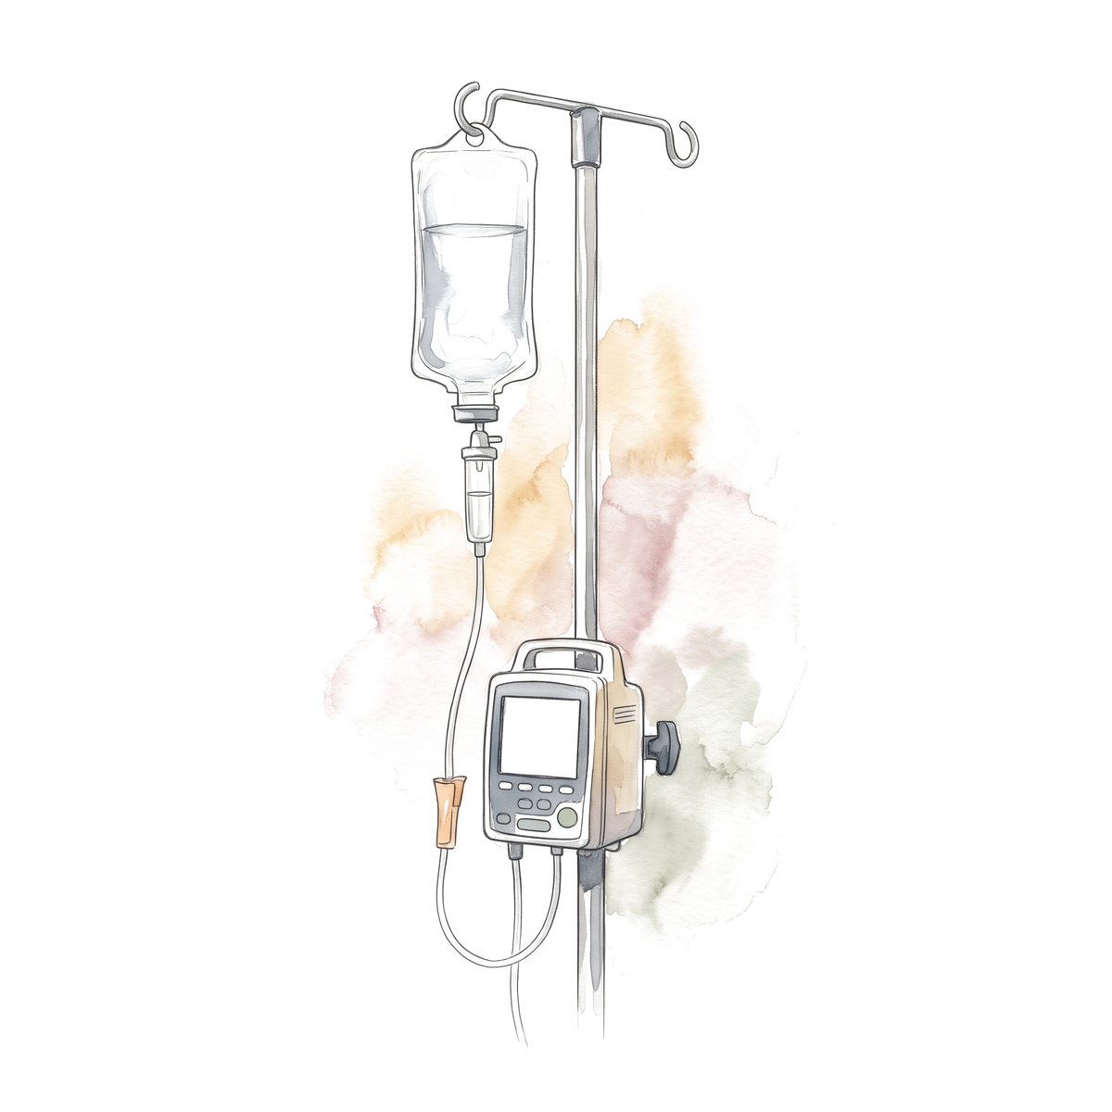
Rituximab, six cycles
What do you give, and for how long?
Rituximab
Entecavir, TDF or TAF
Start
Month 6
Month 12
Month 18
AGA 2025 (PMID 39863345); AASLD 2018 (PMID 29405329); EASL 2025 (PMID 40348683).
27/38
Notes:
High-risk exposure with anti-HBc positive: prophylaxis rather than monitoring (AGA R1, strong). Use a high-barrier drug: entecavir, TDF or TAF. Continue at least 6 months after the immunosuppression ends and at least 12 months for B-cell-depleting therapy (AGA and AASLD 2018); EASL 2025 says 6 to 12 months and at least 18 months after B-cell depletion. For a moderate-risk exposure in a DNA-negative resolved infection, AGA favors prophylaxis but accepts monitoring. ACR 2021 and ASCO 2020 give the rheumatology and oncology versions.

Slide 46
Rituximab, six cycles
What do you give, and for how long?
Rituximab
Entecavir, TDF or TAF
Continue 12 months after the last dose
Start
Month 6
Month 12
Month 18
Start before the first dose. If you only monitor: DNA and ALT every 1 to 3 months
AGA 2025 (PMID 39863345); AASLD 2018 (PMID 29405329); EASL 2025 (PMID 40348683).
27/38
Notes:
High-risk exposure with anti-HBc positive: prophylaxis rather than monitoring (AGA R1, strong). Use a high-barrier drug: entecavir, TDF or TAF. Continue at least 6 months after the immunosuppression ends and at least 12 months for B-cell-depleting therapy (AGA and AASLD 2018); EASL 2025 says 6 to 12 months and at least 18 months after B-cell depletion. For a moderate-risk exposure in a DNA-negative resolved infection, AGA favors prophylaxis but accepts monitoring. ACR 2021 and ASCO 2020 give the rheumatology and oncology versions.

Slide 47
Before immunosuppression: summary
Before chemotherapy or immunosuppression: HBsAg, anti-HBc, anti-HBs
HBsAg positive
HBsAg negative, anti-HBc positive
All negative
Prophylaxis: entecavir, TDF or TAF
High risk (anti-CD20, stem cell transplant): prophylaxis
Vaccinate
Start before the first dose. Continue 6 months after the last, 12 after anti-CD20
Moderate or low risk: DNA and ALT every 1 to 3 months, or prophylaxis
AGA 2025 (PMID 39863345); AASLD 2018 (PMID 29405329); EASL 2025 (PMID 40348683).
28/38
Notes:
AGA 2025: high risk above 10%, moderate 1 to 10%, low below 1%. HBsAg positive: prophylaxis for high- and moderate-risk drugs and for chemotherapy; AGA does not insist on it for every low-risk drug, so say 'nearly all'. HBsAg negative, anti-HBc positive: prophylaxis for anti-CD20 and stem cell transplant; for moderate risk AGA favors prophylaxis but accepts monitoring; low risk is monitoring. Duration: 6 months after the last dose, 12 after B-cell depleting therapy (AGA, AASLD 2018); EASL 2025 says 18 after B-cell depletion. Anti-HBs does not change the decision for anti-CD20. All negative: vaccinate (ACIP: all adults 19 to 59, and 60 and older with risk factors).

Slide 48
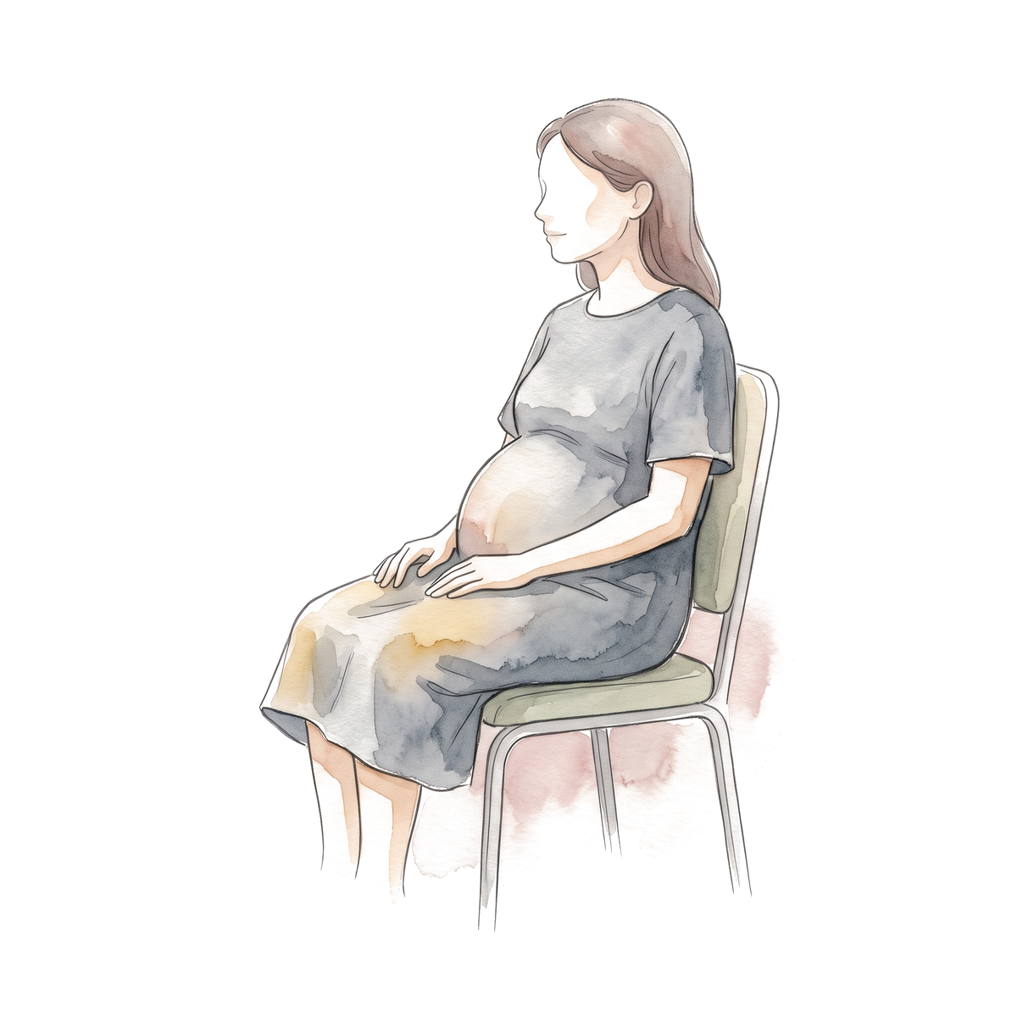
29-year-old woman, 20 weeks pregnant
HBsAg | HBeAg | HBV DNA | ALT
Positive | Positive | 5,000,000 IU/mL | 22 U/L
What do you do for her and for the baby?
29/38
Notes:
Born in Ethiopia, HBeAg positive, all values made up. AASLD/IDSA 2025 R1 (strong, moderate certainty): DNA above 200,000 at any point, start TDF or TAF at week 28 (consider week 16 when infant HBIG is not available). WHO 2024 also treats HBeAg-positive mothers regardless of DNA. Mother's ALT is normal, so this is prophylaxis to prevent transmission; stopping at delivery is allowed when treatment was only for that purpose, with DNA and ALT every 1 to 3 months for 6 months. Infant: single-antigen hepatitis B vaccine plus HBIG within 12 hours at separate sites, then complete the series. Breastfeeding is not prohibited.

Slide 49
29-year-old woman, 20 weeks pregnant
HBsAg | HBeAg | HBV DNA | ALT
Positive | Positive | 5,000,000 IU/mL | 22 U/L
What do you do for her and for the baby?
TDF or TAF from week 28, because DNA is above 200,000 IU/mL
Baby: hepatitis B vaccine and HBIG within 12 hours of birth
29/38
Notes:
Born in Ethiopia, HBeAg positive, all values made up. AASLD/IDSA 2025 R1 (strong, moderate certainty): DNA above 200,000 at any point, start TDF or TAF at week 28 (consider week 16 when infant HBIG is not available). WHO 2024 also treats HBeAg-positive mothers regardless of DNA. Mother's ALT is normal, so this is prophylaxis to prevent transmission; stopping at delivery is allowed when treatment was only for that purpose, with DNA and ALT every 1 to 3 months for 6 months. Infant: single-antigen hepatitis B vaccine plus HBIG within 12 hours at separate sites, then complete the series. Breastfeeding is not prohibited.

Slide 50
Her pregnancy and the baby's first year
Mother: TDF or TAF
Stop at delivery is allowed
Mother: DNA and ALT
Every 1 to 3 months
Baby: vaccine and HBIG
Within 12 hours
Baby: HBsAg and anti-HBs
Month 9 to 12
Week 20
Week 28
Delivery
Month 6
Month 12
AASLD/IDSA 2025 R1 (PMID 41186418); CDC perinatal hepatitis B overview, 2025.
30/38
Notes:
Timeline from the AASLD/IDSA 2025 recommendation and the CDC infant schedule. Infant testing is HBsAg and anti-HBs at 9 to 12 months, or 1 to 2 months after a delayed final dose. Do not use anti-HBc for infant testing after vaccination. Evidence: Pan, NEJM 2016 (200 HBeAg-positive mothers; transmission 5% vs 18% by intention to treat) and Jourdain, NEJM 2018 (331 women; 0 vs 3 infected infants, p = 0.12, not superior because infant prophylaxis was already excellent).

Slide 51
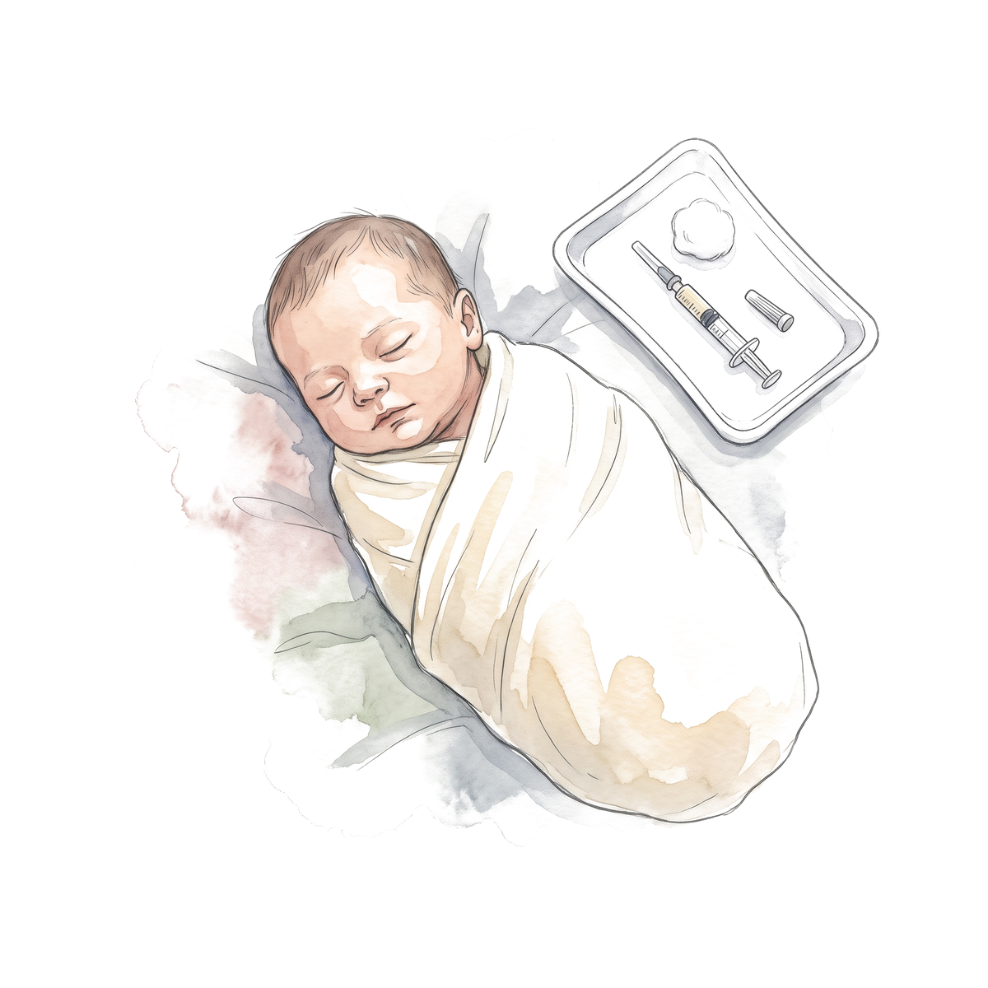
Same woman, after delivery
She is on TDF. Can she breastfeed?
A. No, tenofovir in breast milk harms the baby
B. Yes
C. Only after the baby finishes the vaccine series
D. Only if her DNA is undetectable
AASLD 2018 (PMID 29405329); AASLD/IDSA 2025 (PMID 41186418).
31/38
Notes:
Breastfeeding is not prohibited (AASLD 2018 and AASLD/IDSA 2025). Tenofovir levels in breast milk are low, and the baby has had vaccine and HBIG. Let the room vote first; many think the answer is no.

Slide 52
Same woman, after delivery
She is on TDF. Can she breastfeed?
A. No, tenofovir in breast milk harms the baby
B. Yes
C. Only after the baby finishes the vaccine series
D. Only if her DNA is undetectable
AASLD 2018 (PMID 29405329); AASLD/IDSA 2025 (PMID 41186418).
31/38
Notes:
Breastfeeding is not prohibited (AASLD 2018 and AASLD/IDSA 2025). Tenofovir levels in breast milk are low, and the baby has had vaccine and HBIG. Let the room vote first; many think the answer is no.

Slide 53
Pregnancy: summary
Test HBsAg in every pregnancy
HBsAg positive: check DNA and ALT
DNA above 200,000: TDF or TAF from week 28
Baby: hepatitis B vaccine and HBIG within 12 hours of birth, then finish the series
Test the baby at 9 to 12 months: HBsAg and anti-HBs
Breastfeeding is fine
If she stops after delivery: DNA and ALT every 1 to 3 months for 6 months
AASLD/IDSA 2025 R1 (PMID 41186418); CDC 2023 (PMID 36893044); CDC perinatal hepatitis B guidance.
32/38
Notes:
AASLD/IDSA 2025 R1 (strong, moderate certainty): DNA above 200,000 at any point, start TDF or TAF at week 28; consider week 16 when infant HBIG is not available. Stopping at delivery is allowed when the drug was only for prevention. WHO 2024 also treats HBeAg-positive mothers regardless of DNA. Infant testing: HBsAg and anti-HBs, not anti-HBc. CDC 2023 screens every pregnancy.

Slide 54
Same man, 57 years old, five years on TAF
Condition for stopping | Our patient | Met?
No cirrhosis or advanced disease | Stiffness 5.9 kPa
HBV DNA undetectable for 2 years or more | Undetectable for 5 years
HBsAg under 100 IU/mL | 400 IU/mL
No HIV or HDV | Both negative
Reliable follow-up | Yes
Can he stop?
AASLD/IDSA 2025 R5. Hepatology 2026;83:974-997, PMID 41186418.
33/38
Notes:
HBeAg negative, started on TAF at 52. AASLD/IDSA 2025 R5 (conditional, very low certainty) suggests continuing until HBsAg loss; stopping only in exceptions: no advanced complications, DNA undetectable at least 2 years, qHBsAg under 100, no HIV or HDV, reliable follow-up. If HBeAg-positive at the start, seroconverted at least 1 year. The text says 2 years and the guideline's Figure 4 legend says 3, so quote 2 to 3. If you do stop: DNA and ALT every 1 to 3 months for 6 months, then every 3 months for 6 to 12 months, then every 3 to 6 months. Retreat for DNA 10,000 or more, ALT above 5 times ULN, bilirubin above 2.5 or decompensation (Table 3). Evidence in the extended version. Values are made up.

Slide 55
Same man, 57 years old, five years on TAF
Condition for stopping | Our patient | Met?
No cirrhosis or advanced disease | Stiffness 5.9 kPa | Yes
HBV DNA undetectable for 2 years or more | Undetectable for 5 years | Yes
HBsAg under 100 IU/mL | 400 IU/mL | No
No HIV or HDV | Both negative | Yes
Reliable follow-up | Yes | Yes
Can he stop?
No. Continue until HBsAg is lost
AASLD/IDSA 2025 R5. Hepatology 2026;83:974-997, PMID 41186418.
33/38
Notes:
HBeAg negative, started on TAF at 52. AASLD/IDSA 2025 R5 (conditional, very low certainty) suggests continuing until HBsAg loss; stopping only in exceptions: no advanced complications, DNA undetectable at least 2 years, qHBsAg under 100, no HIV or HDV, reliable follow-up. If HBeAg-positive at the start, seroconverted at least 1 year. The text says 2 years and the guideline's Figure 4 legend says 3, so quote 2 to 3. If you do stop: DNA and ALT every 1 to 3 months for 6 months, then every 3 months for 6 to 12 months, then every 3 to 6 months. Retreat for DNA 10,000 or more, ALT above 5 times ULN, bilirubin above 2.5 or decompensation (Table 3). Evidence in the extended version. Values are made up.

Slide 56
A different patient stops TAF
Which result means restart now?
A. ALT 1.5 times ULN
B. HBV DNA 10,000 IU/mL
C. HBsAg 200 IU/mL
D. Anti-HBs negative
AASLD/IDSA 2025 Table 3 (PMID 41186418).
34/38
Notes:
AASLD/IDSA 2025 Table 3: restart at once for DNA 10,000 or more, ALT above 5 times ULN, bilirubin above 2.5 mg/dL, or decompensation. A mild ALT rise after stopping is expected and is watched, not treated straight away.

Slide 57
A different patient stops TAF
Which result means restart now?
A. ALT 1.5 times ULN
B. HBV DNA 10,000 IU/mL
C. HBsAg 200 IU/mL
D. Anti-HBs negative
AASLD/IDSA 2025 Table 3 (PMID 41186418).
34/38
Notes:
AASLD/IDSA 2025 Table 3: restart at once for DNA 10,000 or more, ALT above 5 times ULN, bilirubin above 2.5 mg/dL, or decompensation. A mild ALT rise after stopping is expected and is watched, not treated straight away.

Slide 58
Stopping: summary
Default: continue until HBsAg is lost
Stop only if all of these:
No cirrhosis
DNA undetectable for 2 years or more
HBsAg under 100 IU/mL
No HIV or HDV
Reliable follow-up
After stopping
Months 0 to 6: DNA and ALT every 1 to 3 months
Months 6 to 12: every 3 months
After 12 months: every 3 to 6 months
Restart now: DNA 10,000 or more, ALT above 5 times ULN, bilirubin above 2.5 mg/dL, or decompensation
AASLD/IDSA 2025 R5 and Table 3 (PMID 41186418).
35/38
Notes:
R5 is conditional, very low certainty. If HBeAg-positive at the start, also seroconverted for at least 1 year. The text says 2 years of suppression and the Figure 4 legend says 3. Follow-up and retreatment triggers are from Table 3; the table says ALT above 5 times ULN and the prose says 5 times or more.

Slide 59
Approved in 2026
 | Bepirovirsen (Hibsago) | Bulevirtide (Hepcludex)
For | Chronic hepatitis B | Chronic hepatitis D
FDA approval | 20 October 2026 | 22 May 2026
Who | Adults without cirrhosis, on a nucleos(t)ide analogue 6 months or more, DNA suppressed, HBsAg 3,000 IU/mL or lower | Adults without cirrhosis or with compensated cirrhosis
Result | 19% had HBsAg undetectable 24 weeks after stopping all treatment; 0% on placebo | Week 48: combined response 48% vs 2%
Warning | Liver reactions, low platelets | Severe exacerbation if stopped
FDA news releases 20 October 2026 (bepirovirsen) and 22 May 2026 (bulevirtide). B-Well 1 and 2, Hou, NEJM 2026.
36/38
Notes:
From the FDA pages. Bepirovirsen is an antisense oligonucleotide given under the skin for up to 24 weeks, together with the existing antiviral, which continues for at least 24 weeks after the last injection; some patients can then stop it. Across the two trials 24% met the criteria to stop their existing medicine versus none on placebo, and 19% still had suppressed virus with undetectable HBsAg 24 weeks after stopping all hepatitis B treatment. The FDA also authorized a Roche qHBsAg assay as a companion diagnostic. Boxed warning for serious liver reactions and low platelets; warnings include worsening kidney function and vasculitis. Hepcludex: accelerated approval, boxed warning for severe exacerbations of HDV and HBV on discontinuation.

Slide 60
Back to our patients
 | Patient | Decision
1 | Man, 34 to 57. HBeAg-positive, then HBeAg-negative with DNA 8,000 and ALT 48 | Monitor at 34. Treatment suggested at 41, he waited. TAF at 52. PAGE-B 18, surveillance. Do not stop with HBsAg 400
2 | Woman, 61. Anti-HBc positive, HBsAg negative, rituximab | Entecavir, TDF or TAF before the first dose and for 12 months after the last
3 | Woman, 29, 20 weeks pregnant. DNA 5,000,000 | TDF or TAF from week 28. Vaccine and HBIG within 12 hours. Test the baby at 9 to 12 months
37/38
Notes:
Close the loop on the three patients. Then take questions.

Slide 61
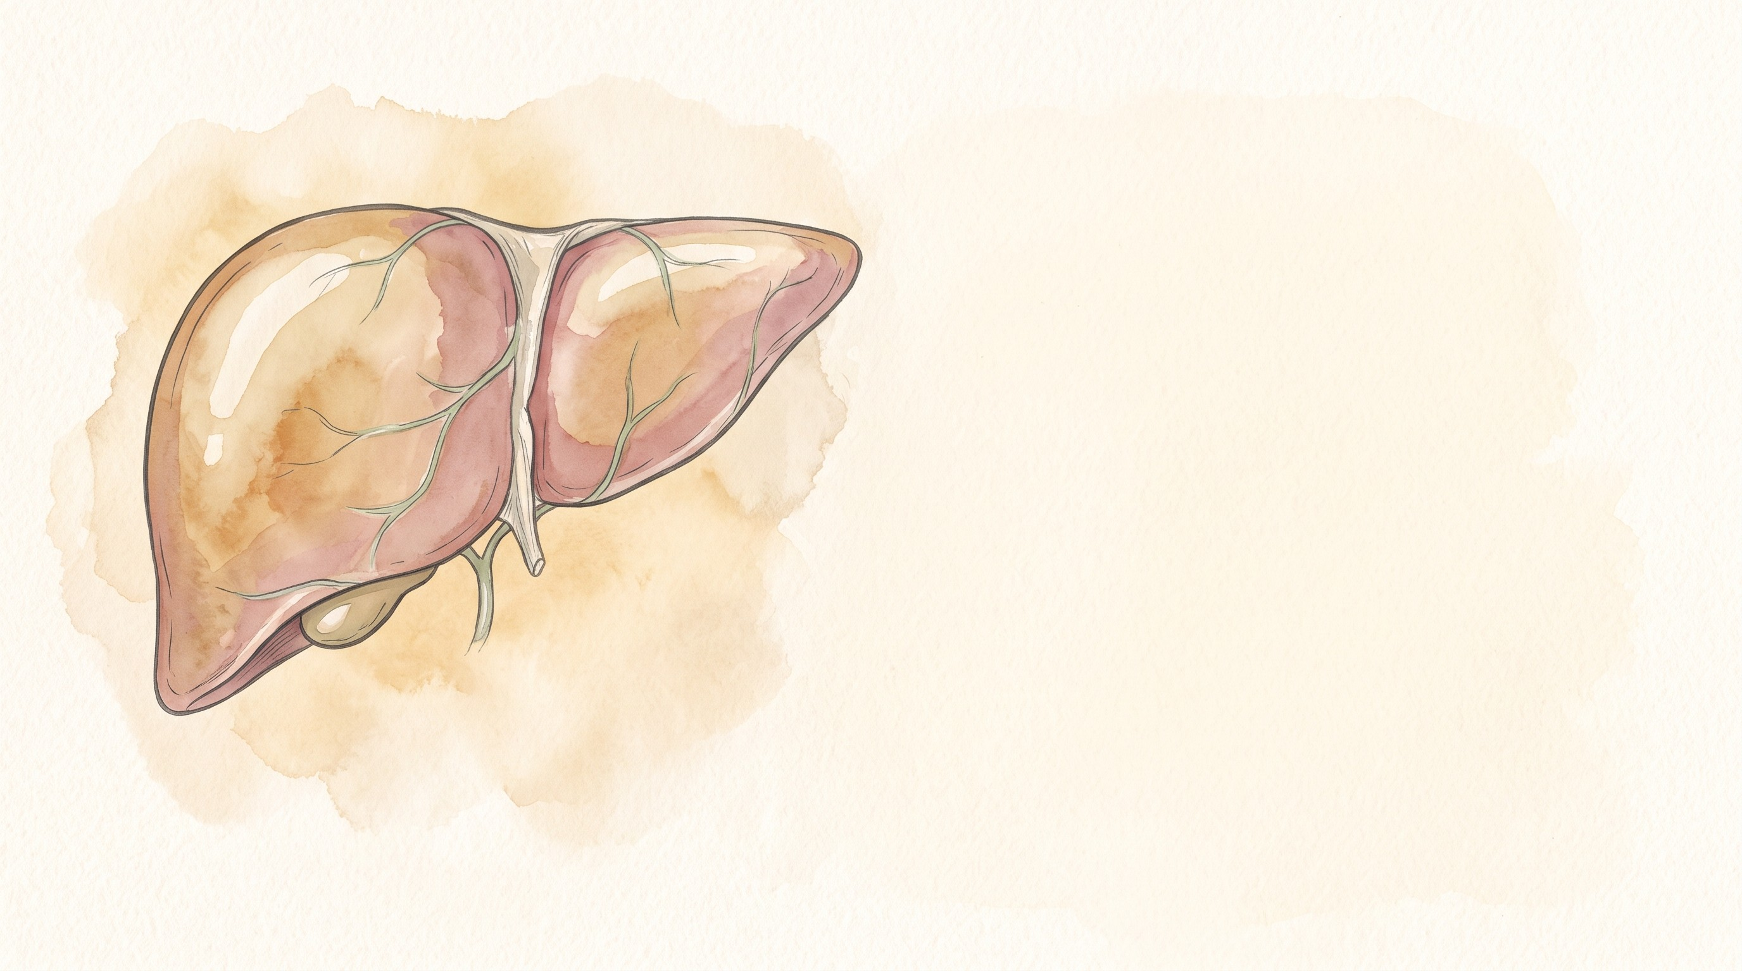
Questions?
X: @mfalmeqdadi
Slides (PDF)
38/38
Notes:
The QR code opens the slides PDF. The HBV HCC risk calculator is at qaddodi.github.io/chb-hcc-risk.

